Slide 1
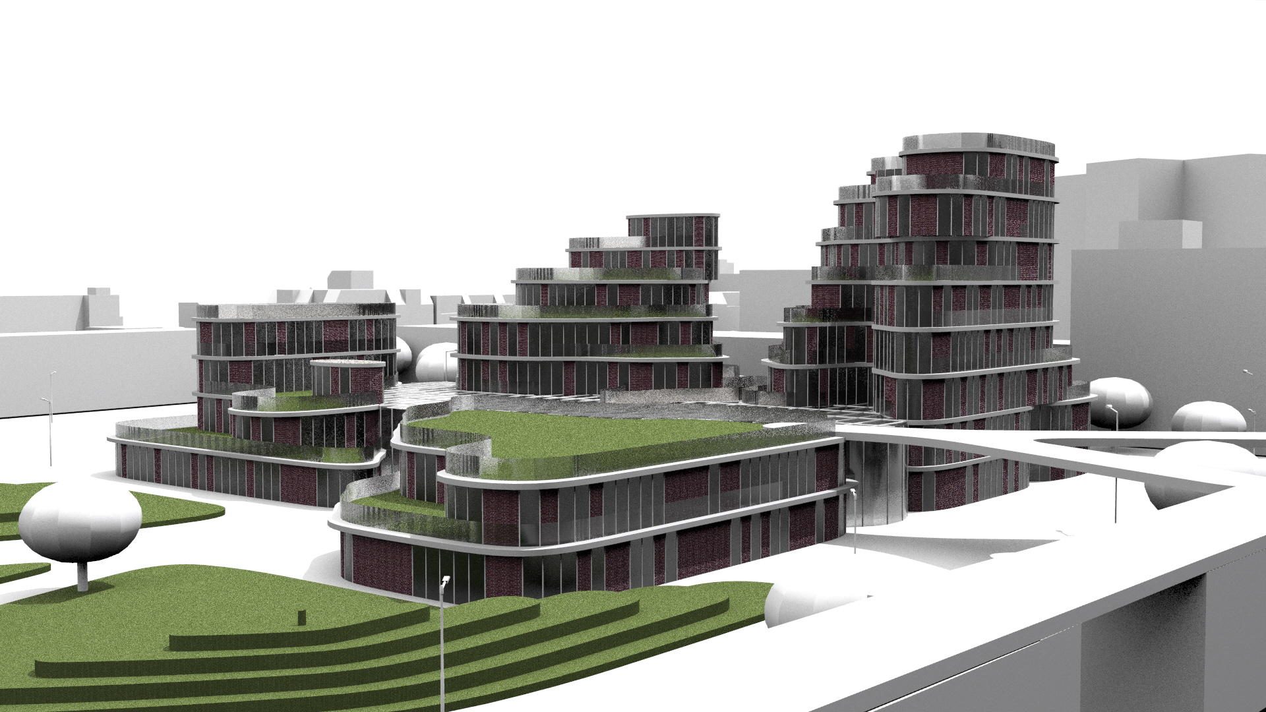
Computational Design Studio: Piece of Cake
Design Challenge: Micropolis Rotterdam

Slide 2
Summary
Overview of the process
Concept of the building
Voxelisation of the building plot
Solar envelope
Graph relaxation
Shadow analysis
Noise analysis
Growing algorithm
Path finding algorithm
Design
Reflection of the process

Slide 3
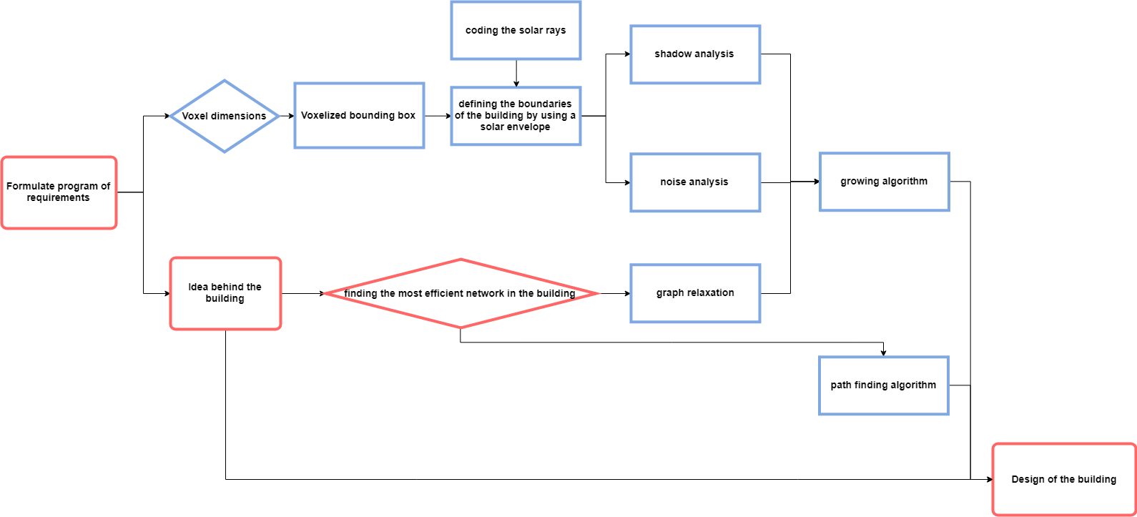
Overview of the process: simplified flowchart

Slide 4

Overview of the process: development of the building
Concept of the building
Voxelisation of the building plot
Solar envelope
Graph relaxation
Noise analysis
Shadow analysis
Function analysis
Growing algorithm
Design
Path finding algorithm

Slide 5
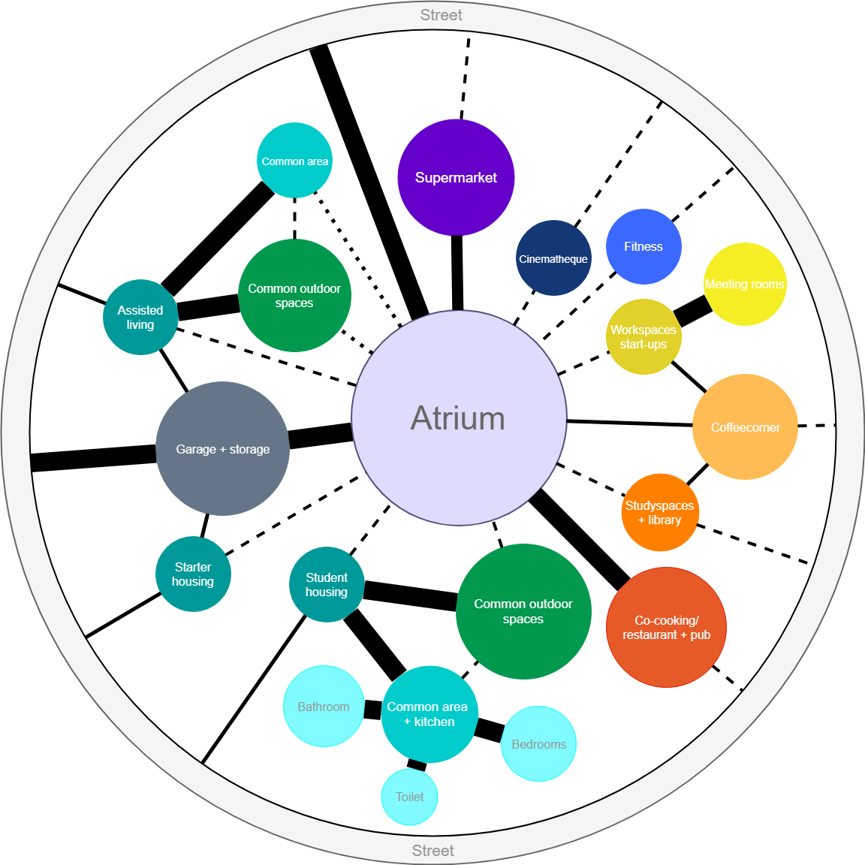
Overview of the process
Concept of the building
Voxelisation of the building plot
Solar envelope
Graph relaxation
Noise analysis
Shadow analysis
Function analysis
Growing algorithm
Design
Path finding algorithm

Slide 6
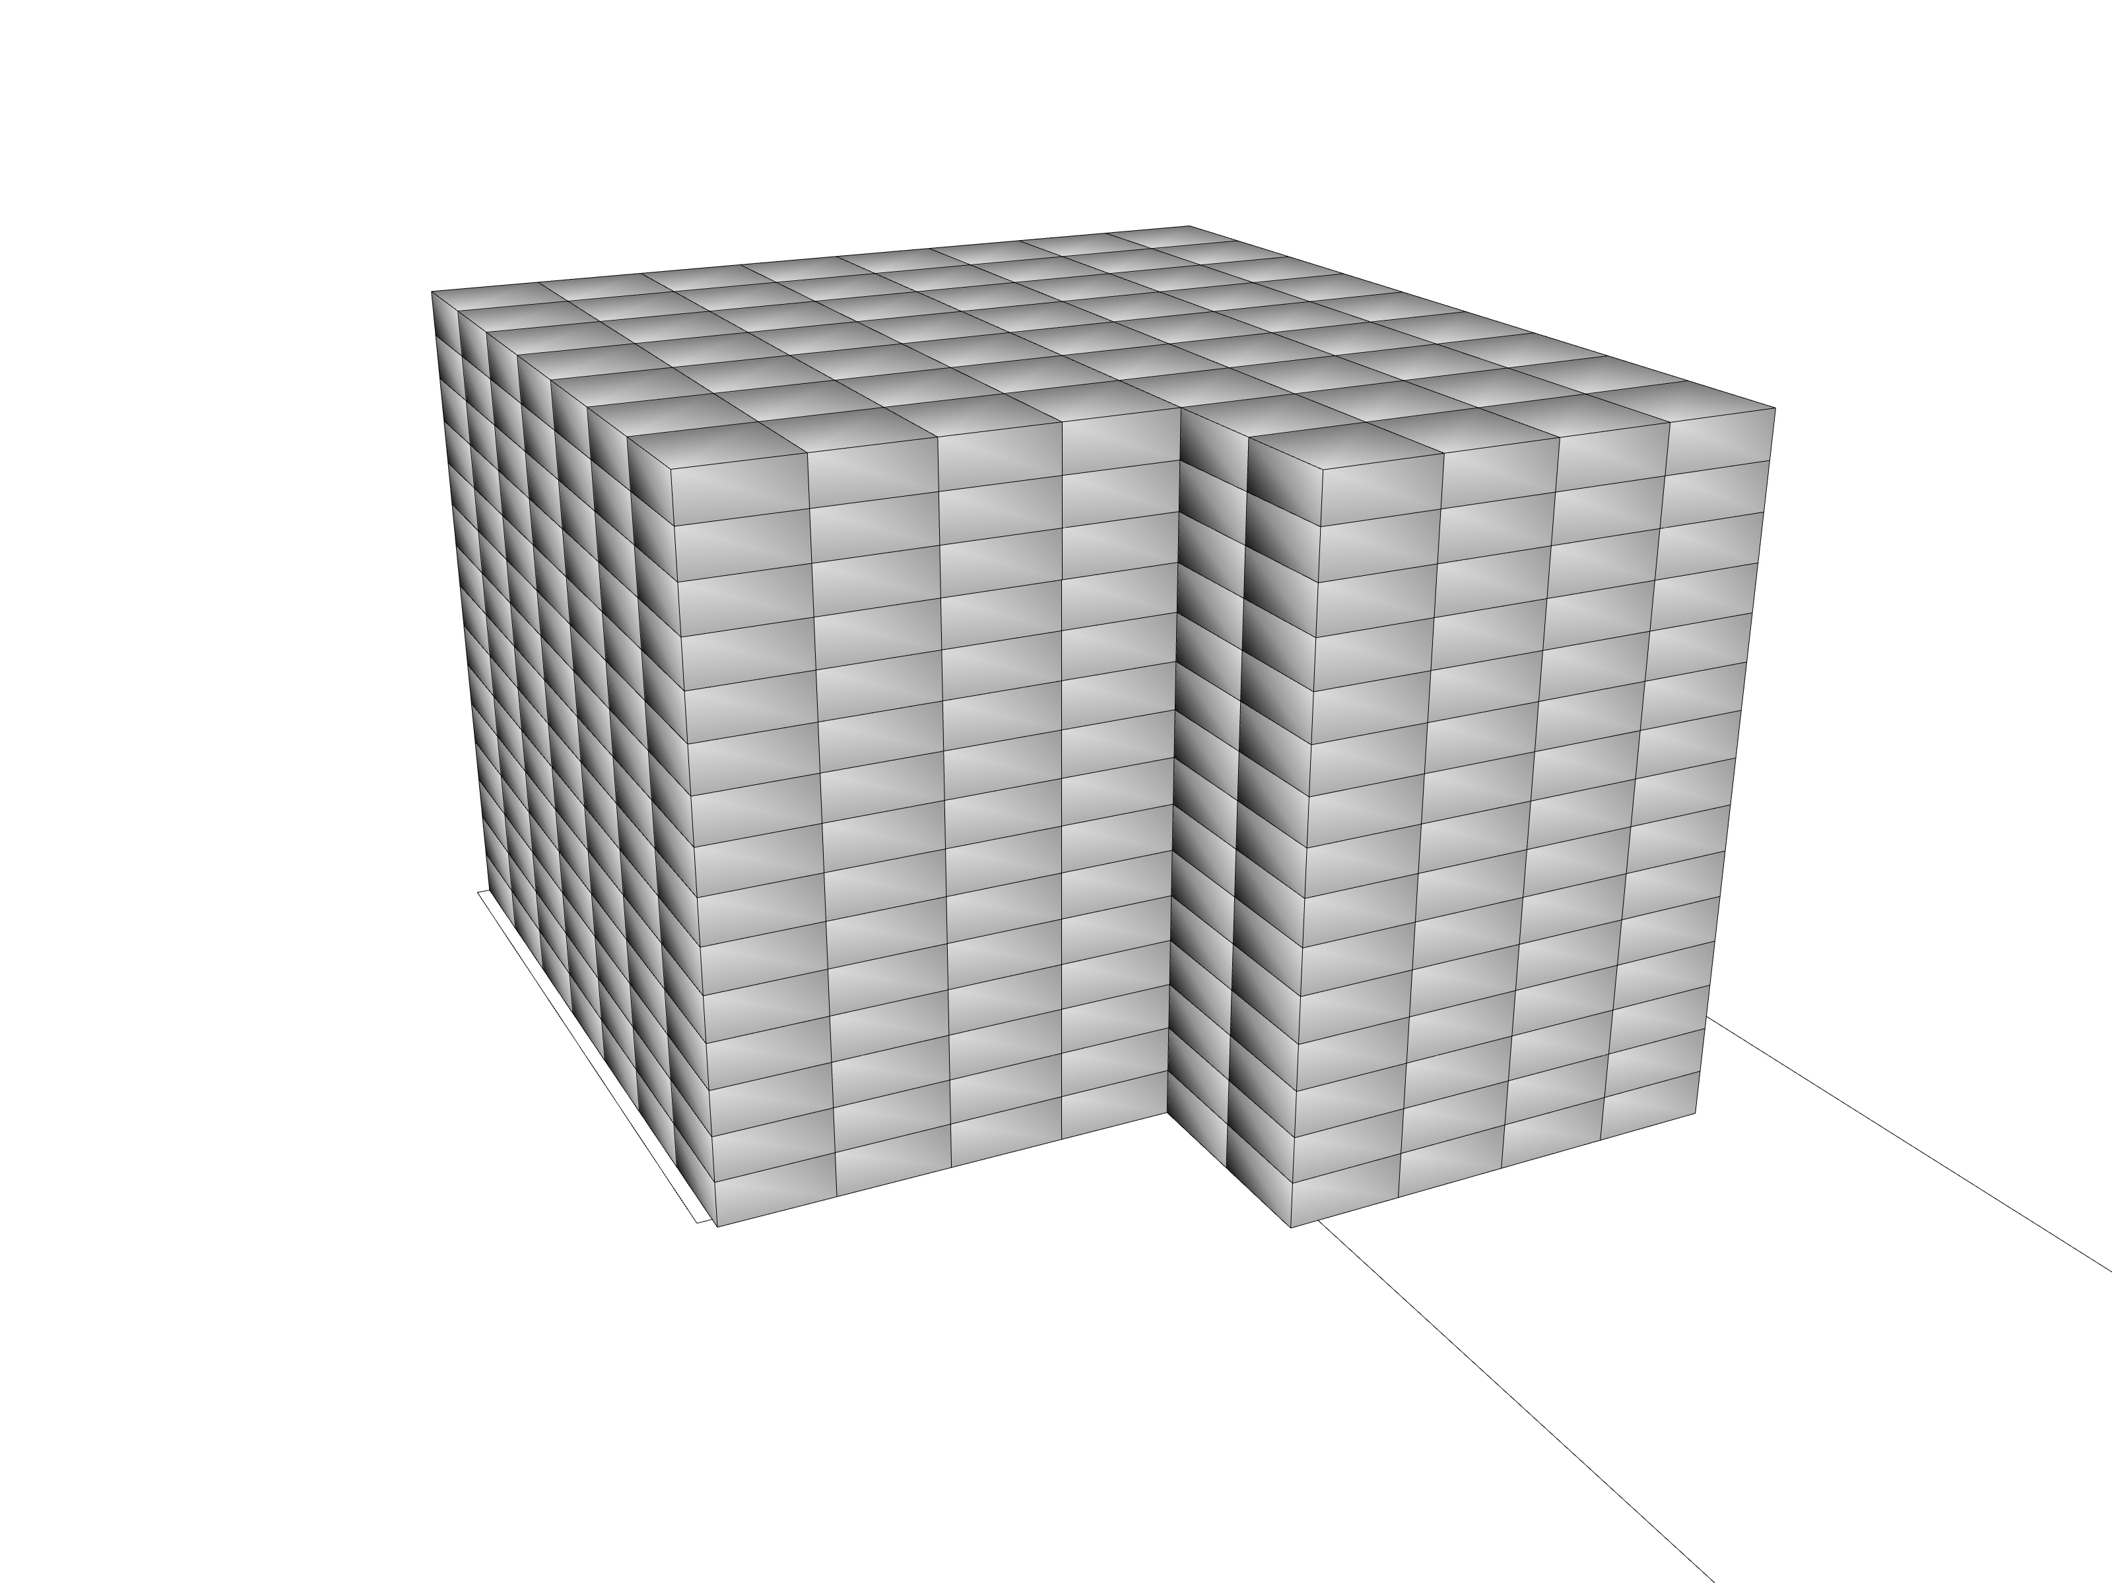
Overview of the process
Concept of the building
Voxelisation of the building plot
Solar envelope
Graph relaxation
Noise analysis
Shadow analysis
Function analysis
Growing algorithm
Design
Path finding algorithm

Slide 7
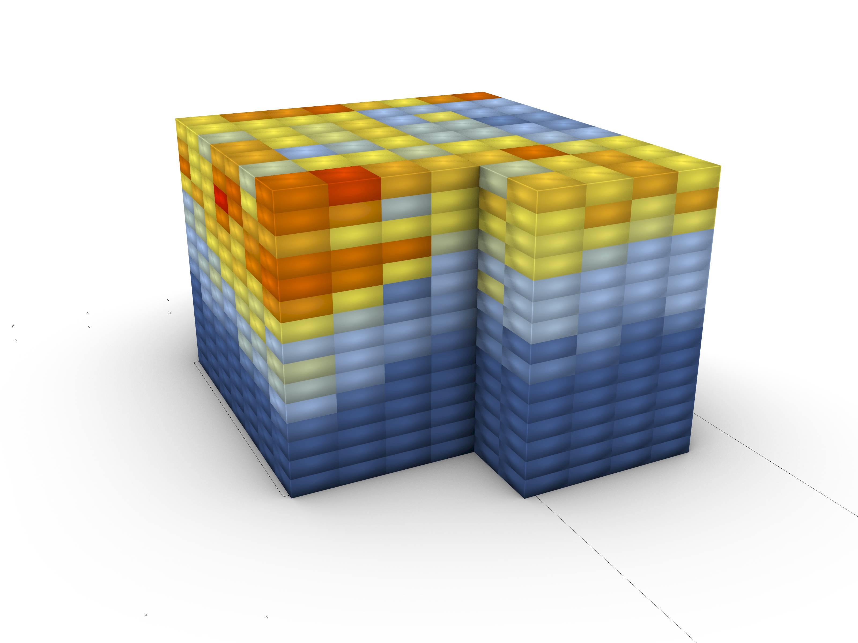
Overview of the process
Concept of the building
Voxelisation of the building plot
Solar envelope
Graph relaxation
Noise analysis
Shadow analysis
Function analysis
Growing algorithm
Design
Path finding algorithm

Slide 8
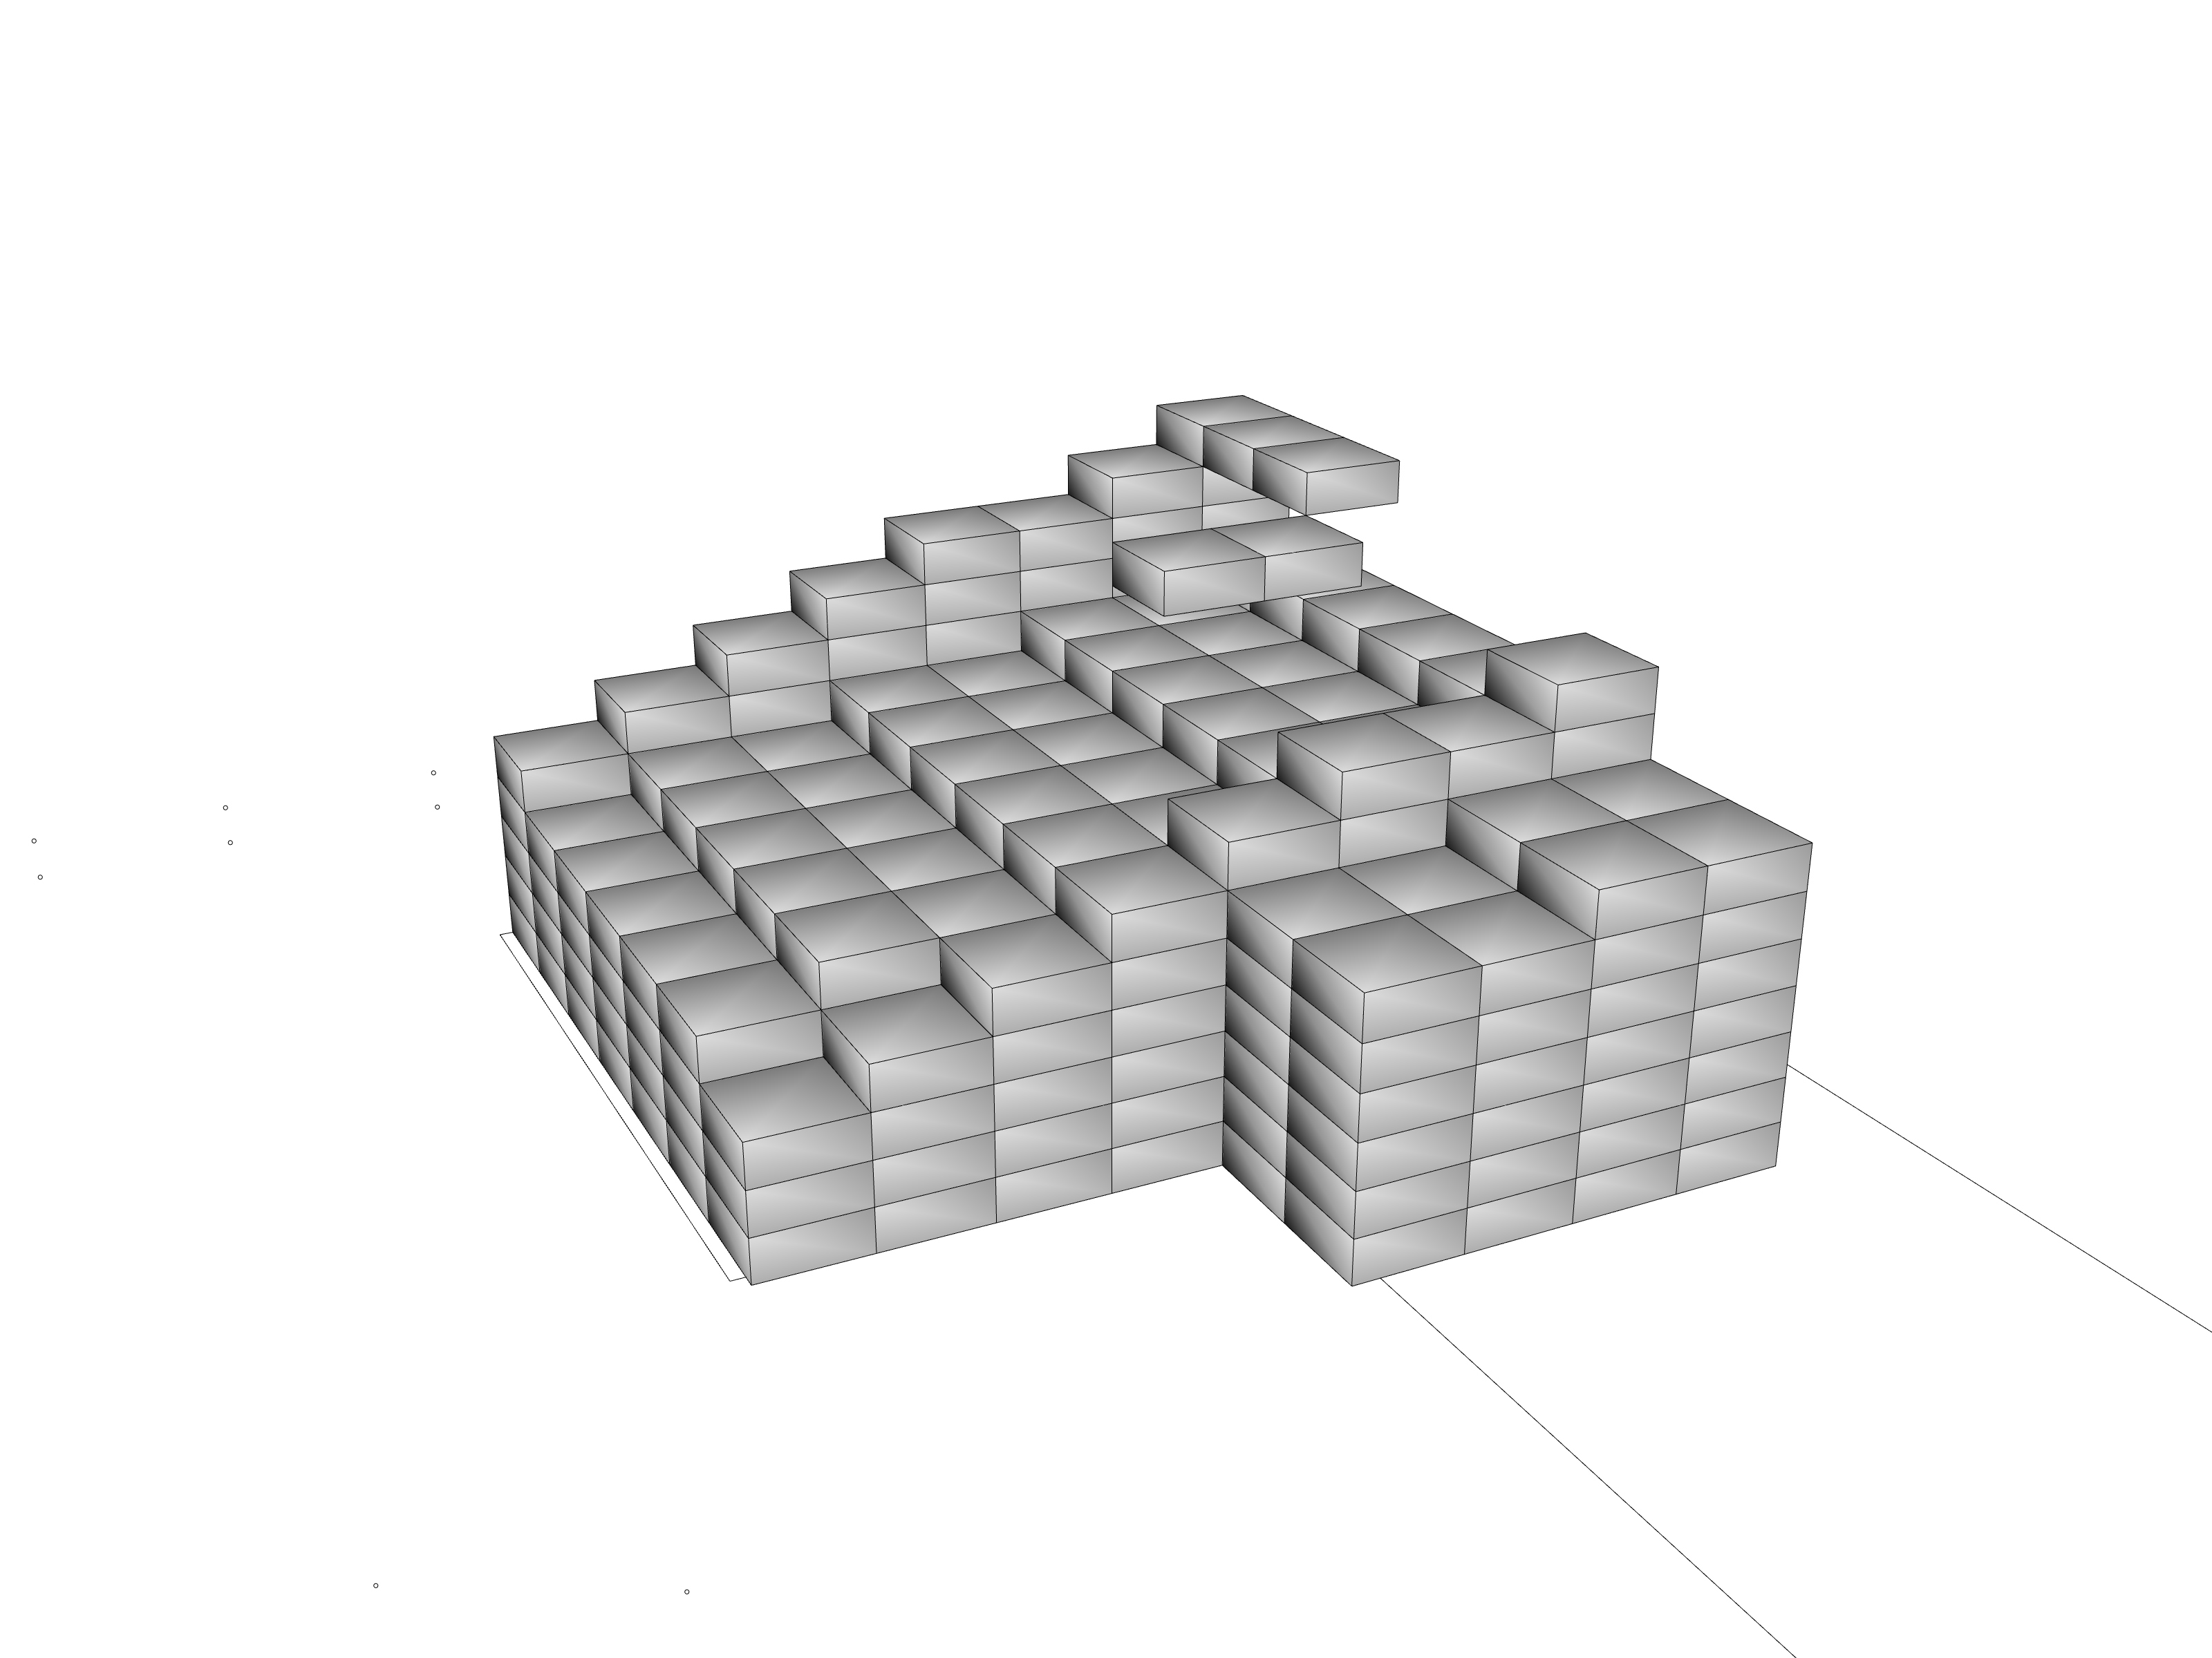
Overview of the process
Concept of the building
Voxelisation of the building plot
Solar envelope
Graph relaxation
Noise analysis
Shadow analysis
Function analysis
Growing algorithm
Design
Path finding algorithm

Slide 9
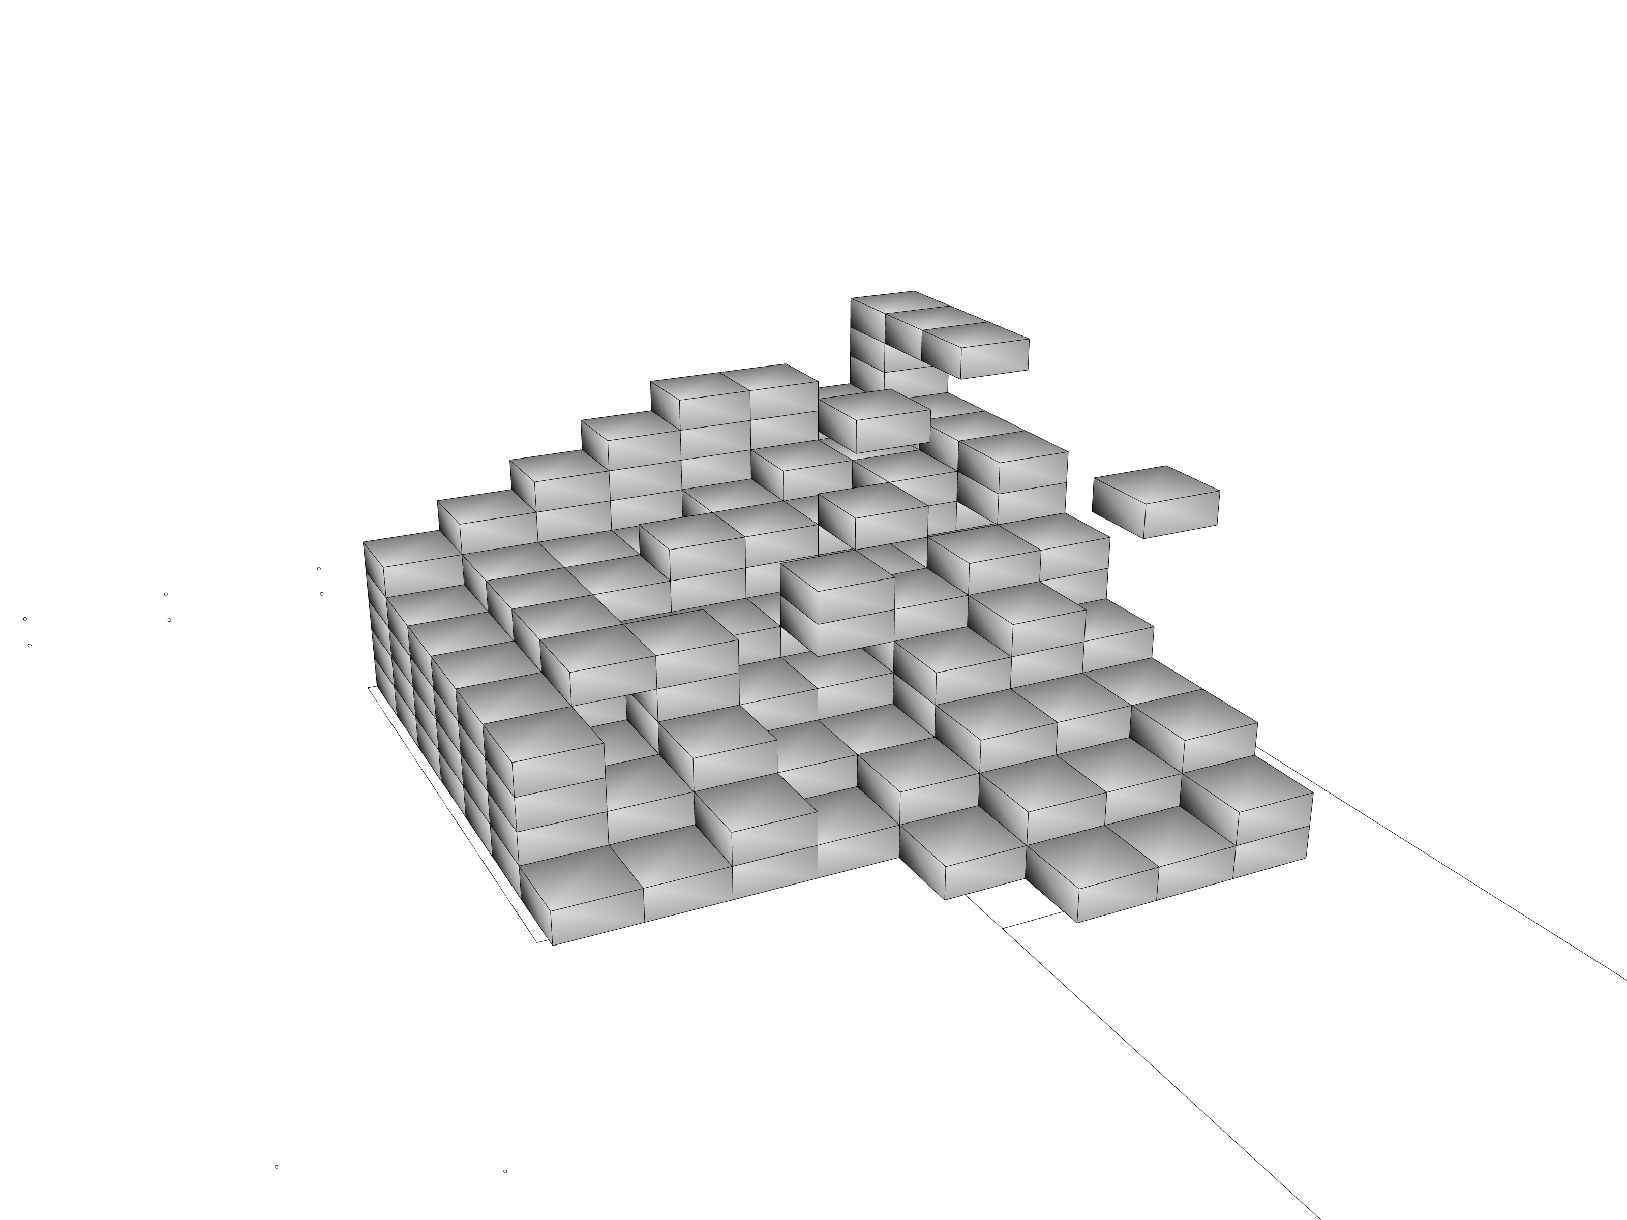
Overview of the process
Concept of the building
Voxelisation of the building plot
Solar envelope
Graph relaxation
Noise analysis
Shadow analysis
Function analysis
Growing algorithm
Design
Path finding algorithm

Slide 10
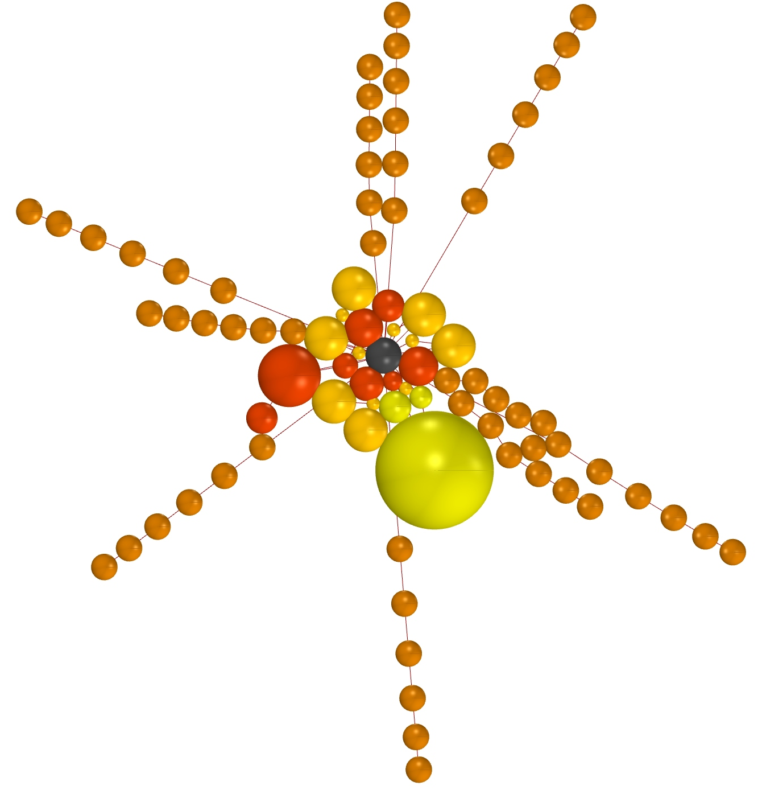
Overview of the process
Concept of the building
Voxelisation of the building plot
Solar envelope
Graph relaxation
Noise analysis
Shadow analysis
Function analysis
Growing algorithm
Design
Path finding algorithm

Slide 11
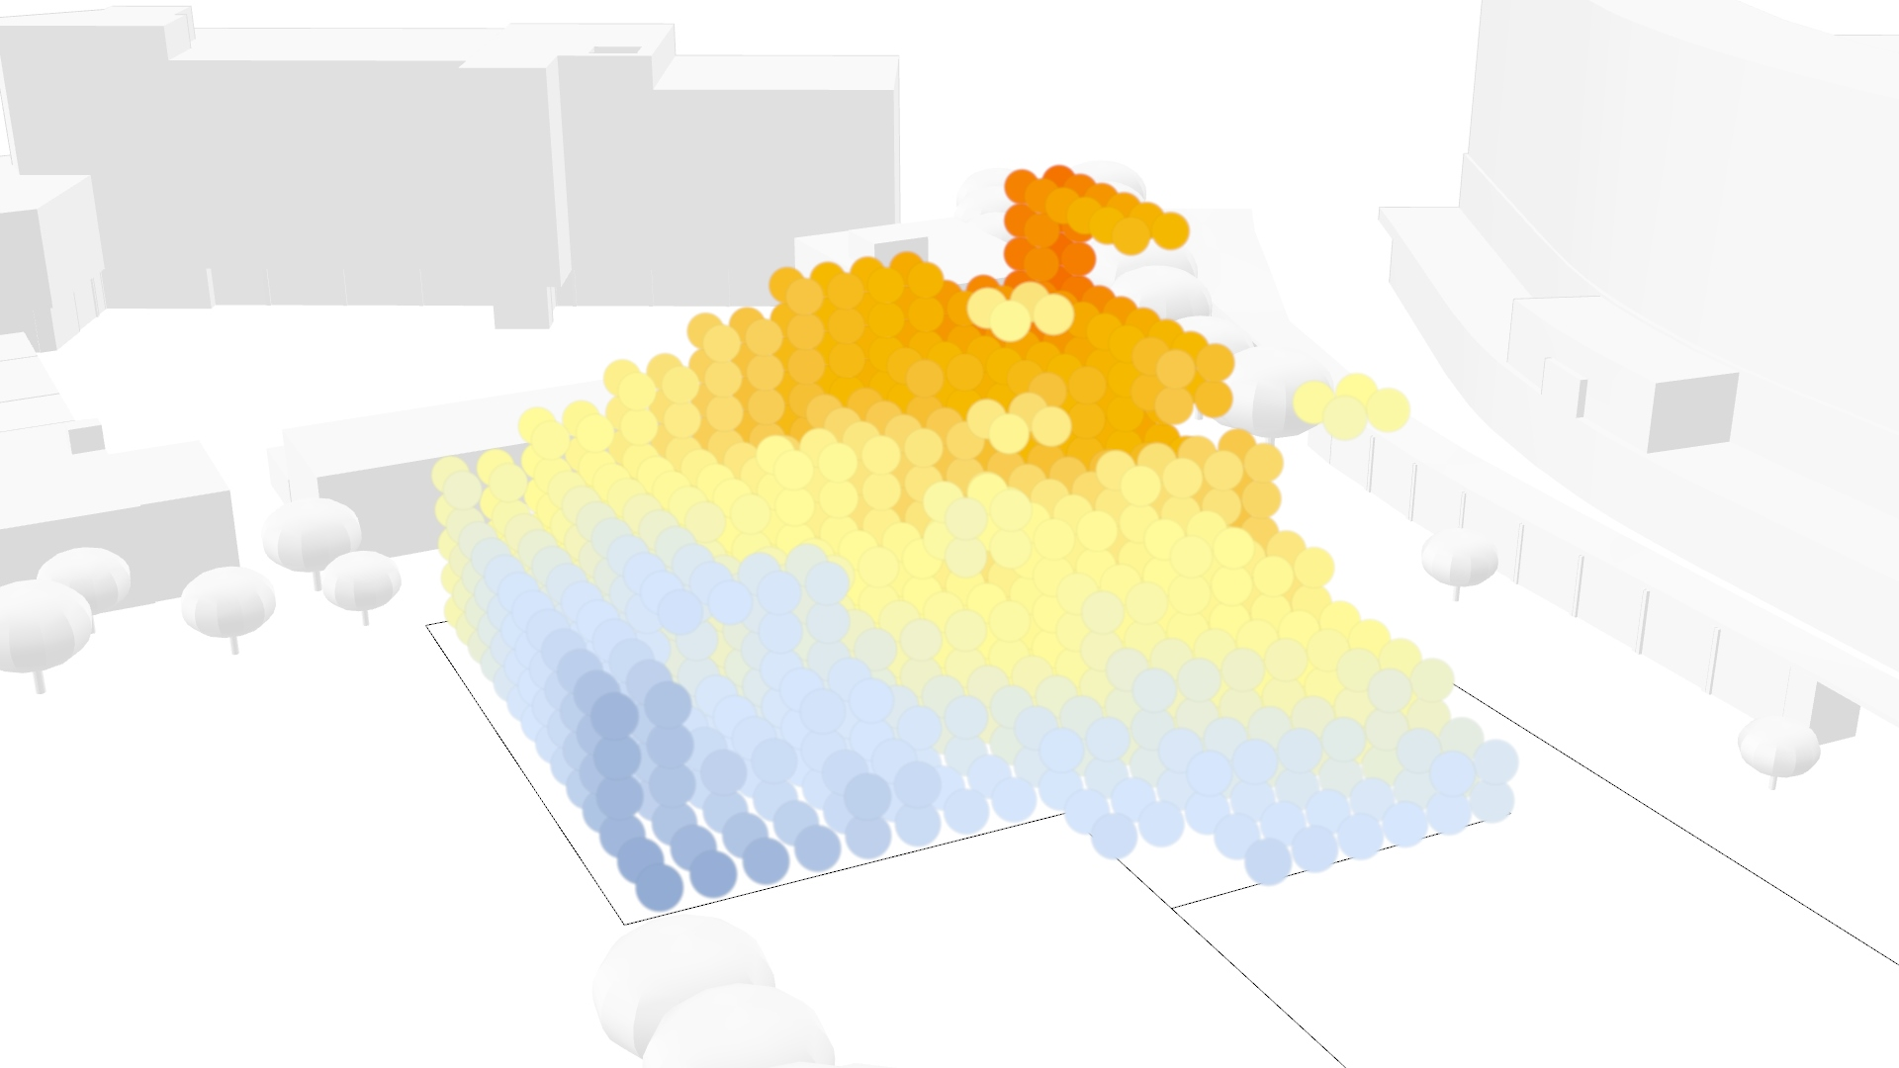
Overview of the process
Concept of the building
Voxelisation of the building plot
Solar envelope
Graph relaxation
Noise analysis
Shadow analysis
Function analysis
Growing algorithm
Design
Path finding algorithm

Slide 12
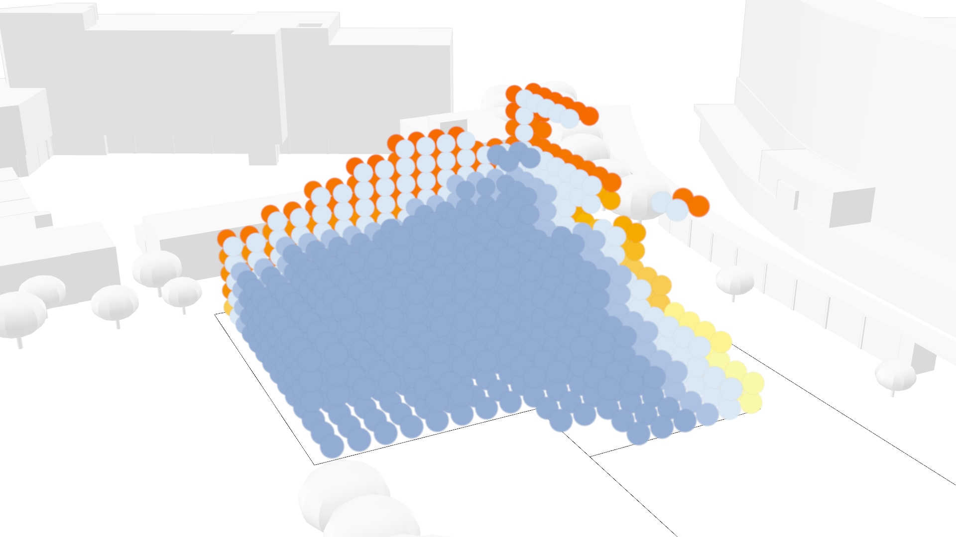
Overview of the process
Concept of the building
Voxelisation of the building plot
Solar envelope
Graph relaxation
Noise analysis
Shadow analysis
Function analysis
Growing algorithm
Design
Path finding algorithm

Slide 13
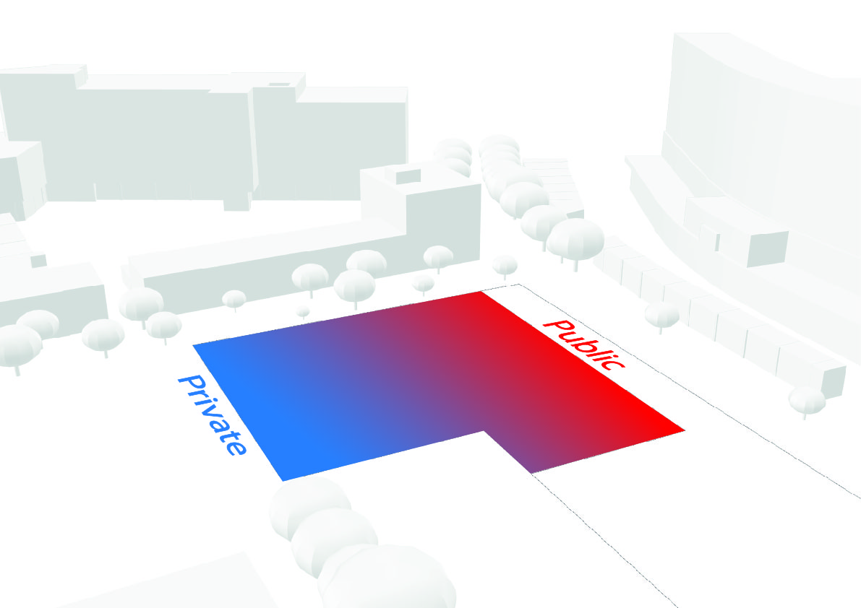
Overview of the process
Concept of the building
Voxelisation of the building plot
Solar envelope
Graph relaxation
Noise analysis
Shadow analysis
Function analysis
Growing algorithm
Design
Path finding algorithm

Slide 14
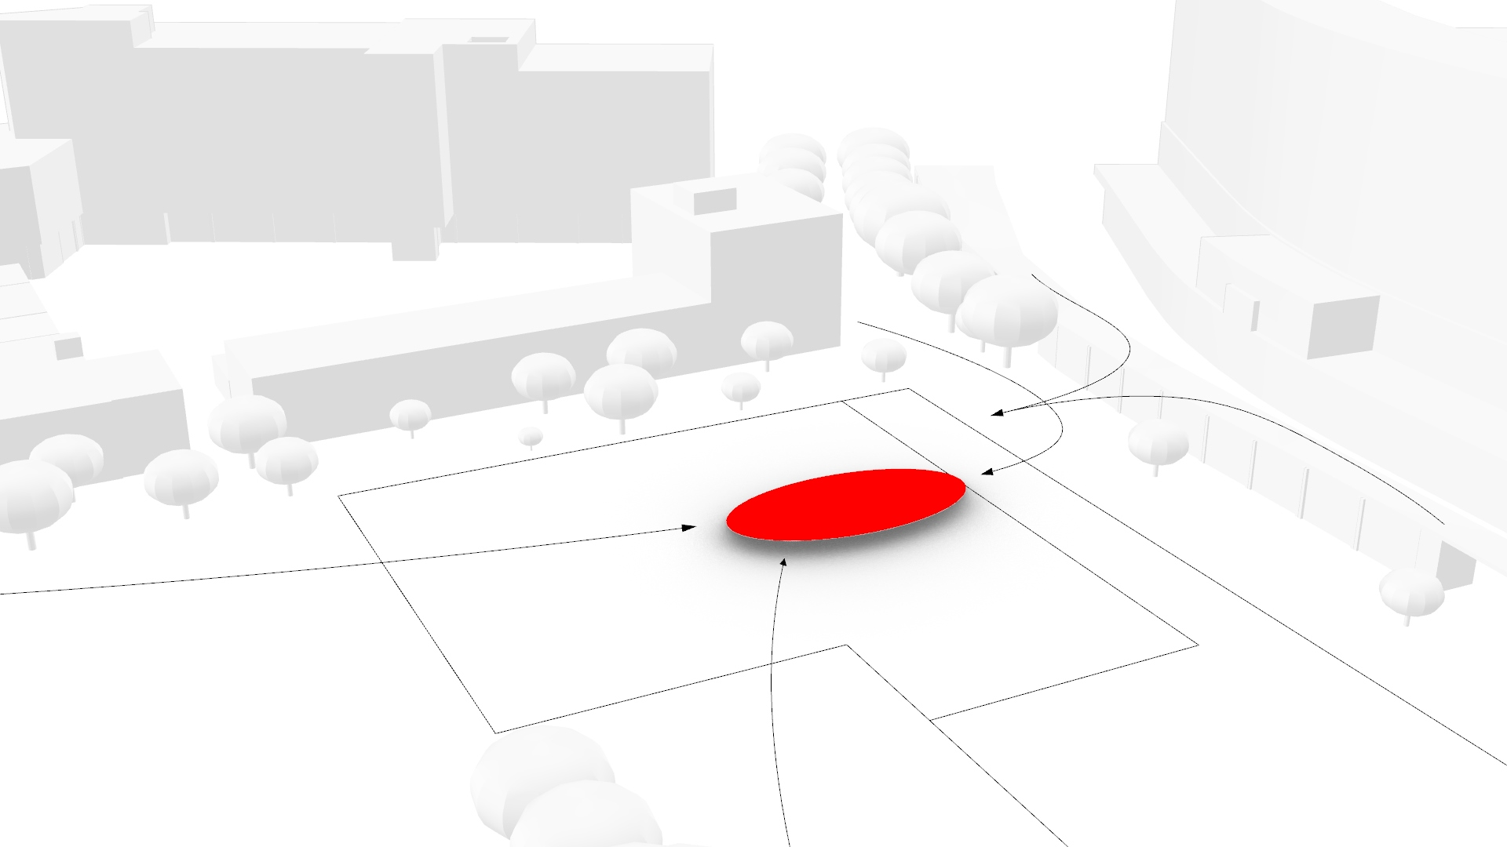
Overview of the process
Concept of the building
Voxelisation of the building plot
Solar envelope
Graph relaxation
Noise analysis
Shadow analysis
Function analysis
Growing algorithm
Design
Path finding algorithm

Slide 15
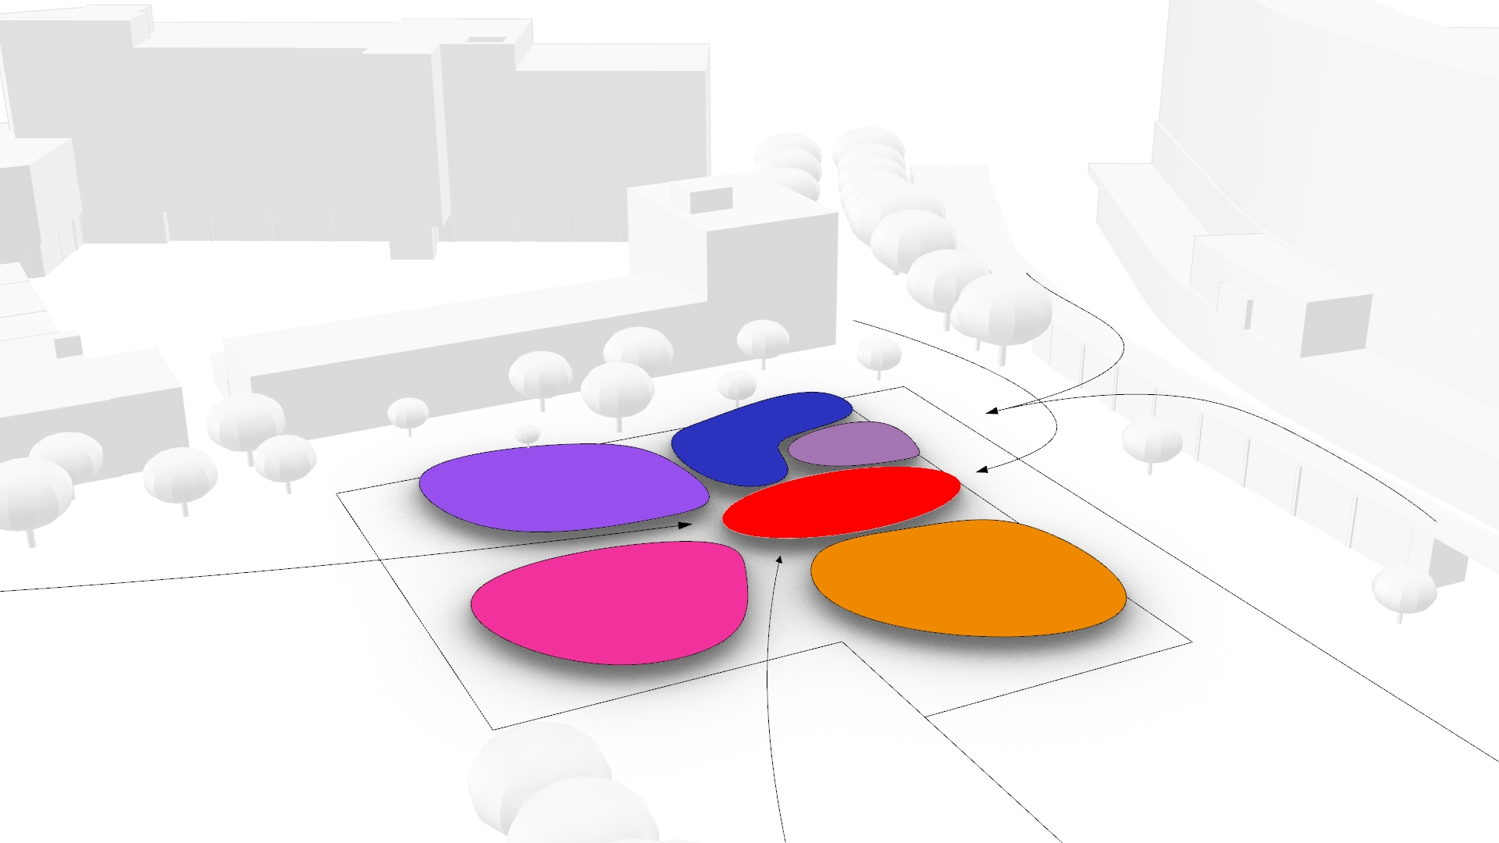
Overview of the process
Concept of the building
Voxelisation of the building plot
Solar envelope
Graph relaxation
Noise analysis
Shadow analysis
Function analysis
Growing algorithm
Design
Path finding algorithm

Slide 16
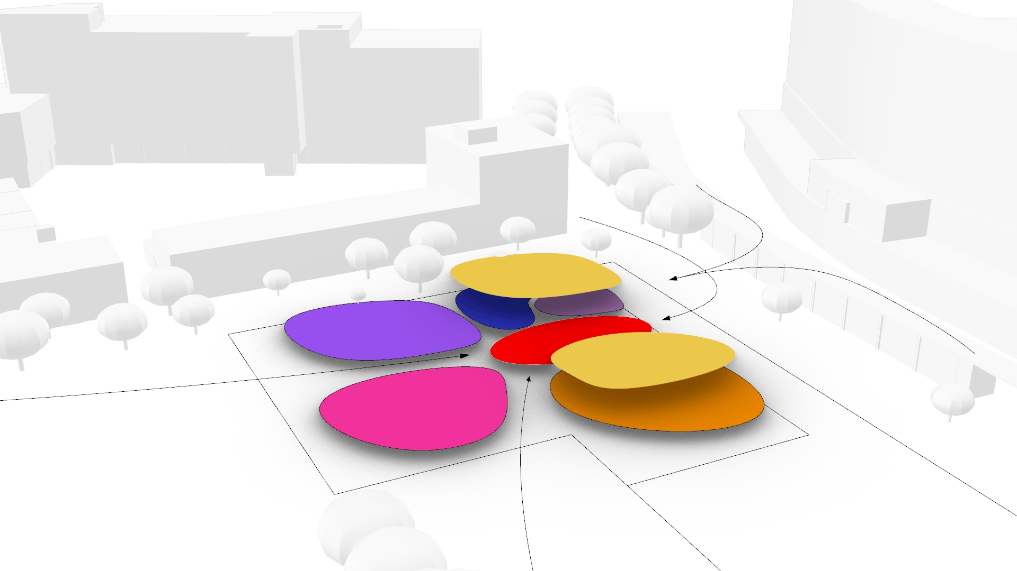
Overview of the process
Concept of the building
Voxelisation of the building plot
Solar envelope
Graph relaxation
Noise analysis
Shadow analysis
Function analysis
Growing algorithm
Design
Path finding algorithm

Slide 17
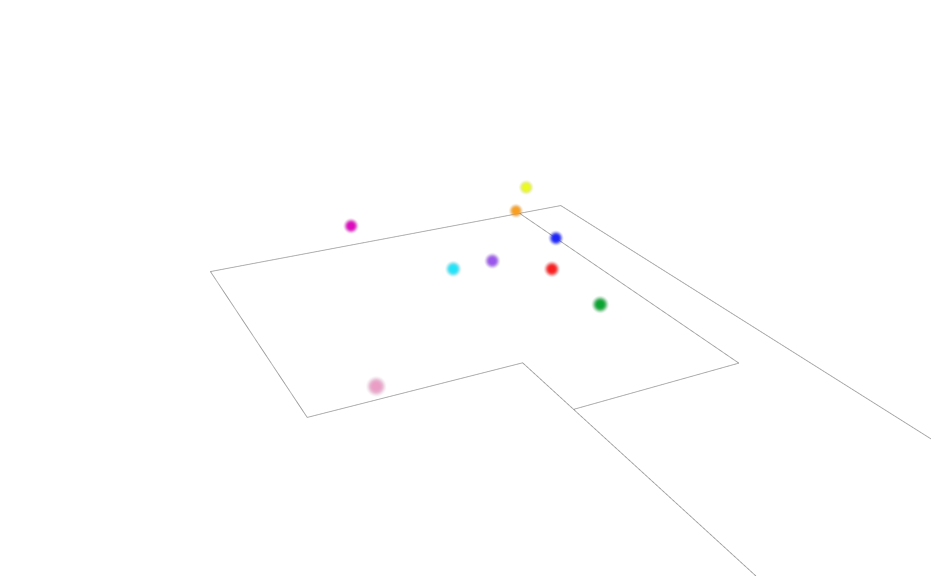
Overview of the process
Concept of the building
Voxelisation of the building plot
Solar envelope
Graph relaxation
Noise analysis
Shadow analysis
Function analysis
Growing algorithm
Design
Path finding algorithm

Slide 18
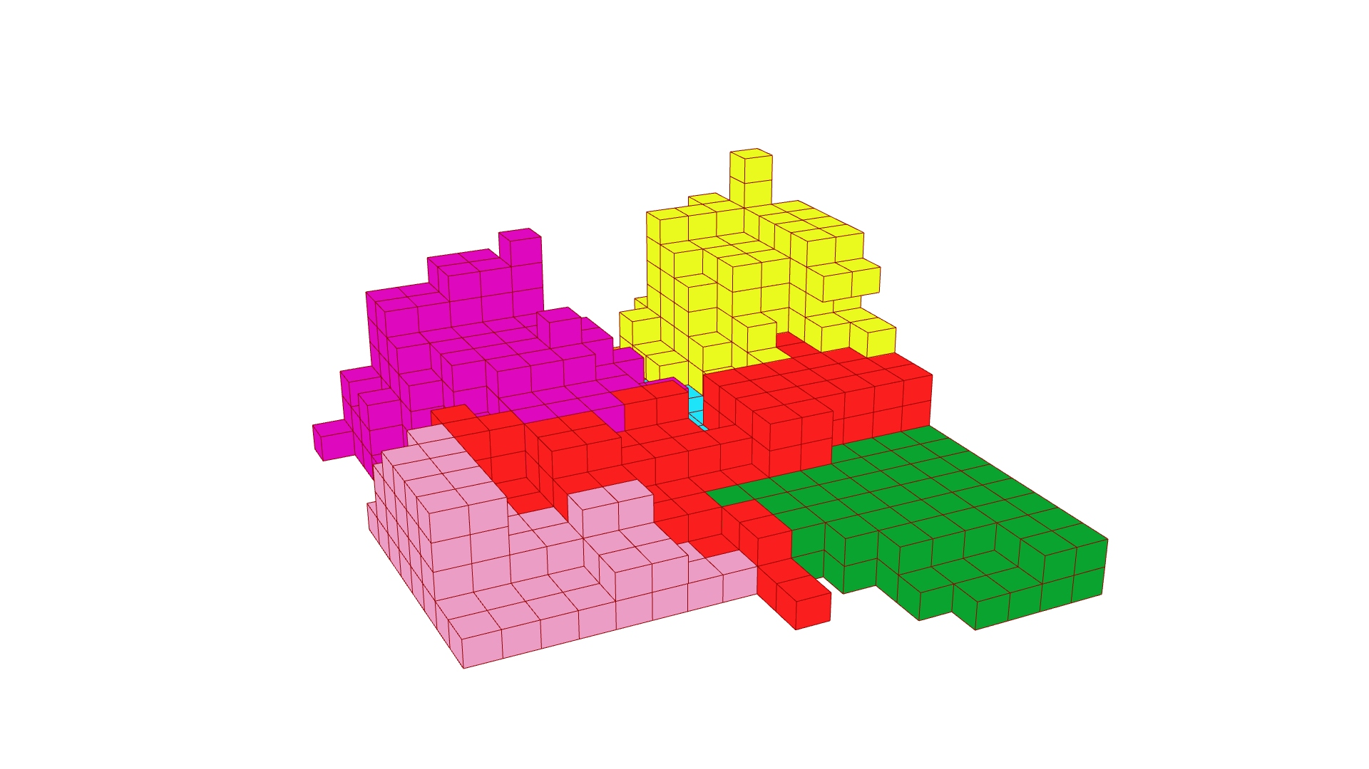
Overview of the process
Concept of the building
Voxelisation of the building plot
Solar envelope
Graph relaxation
Noise analysis
Shadow analysis
Function analysis
Growing algorithm
Design
Path finding algorithm

Slide 19
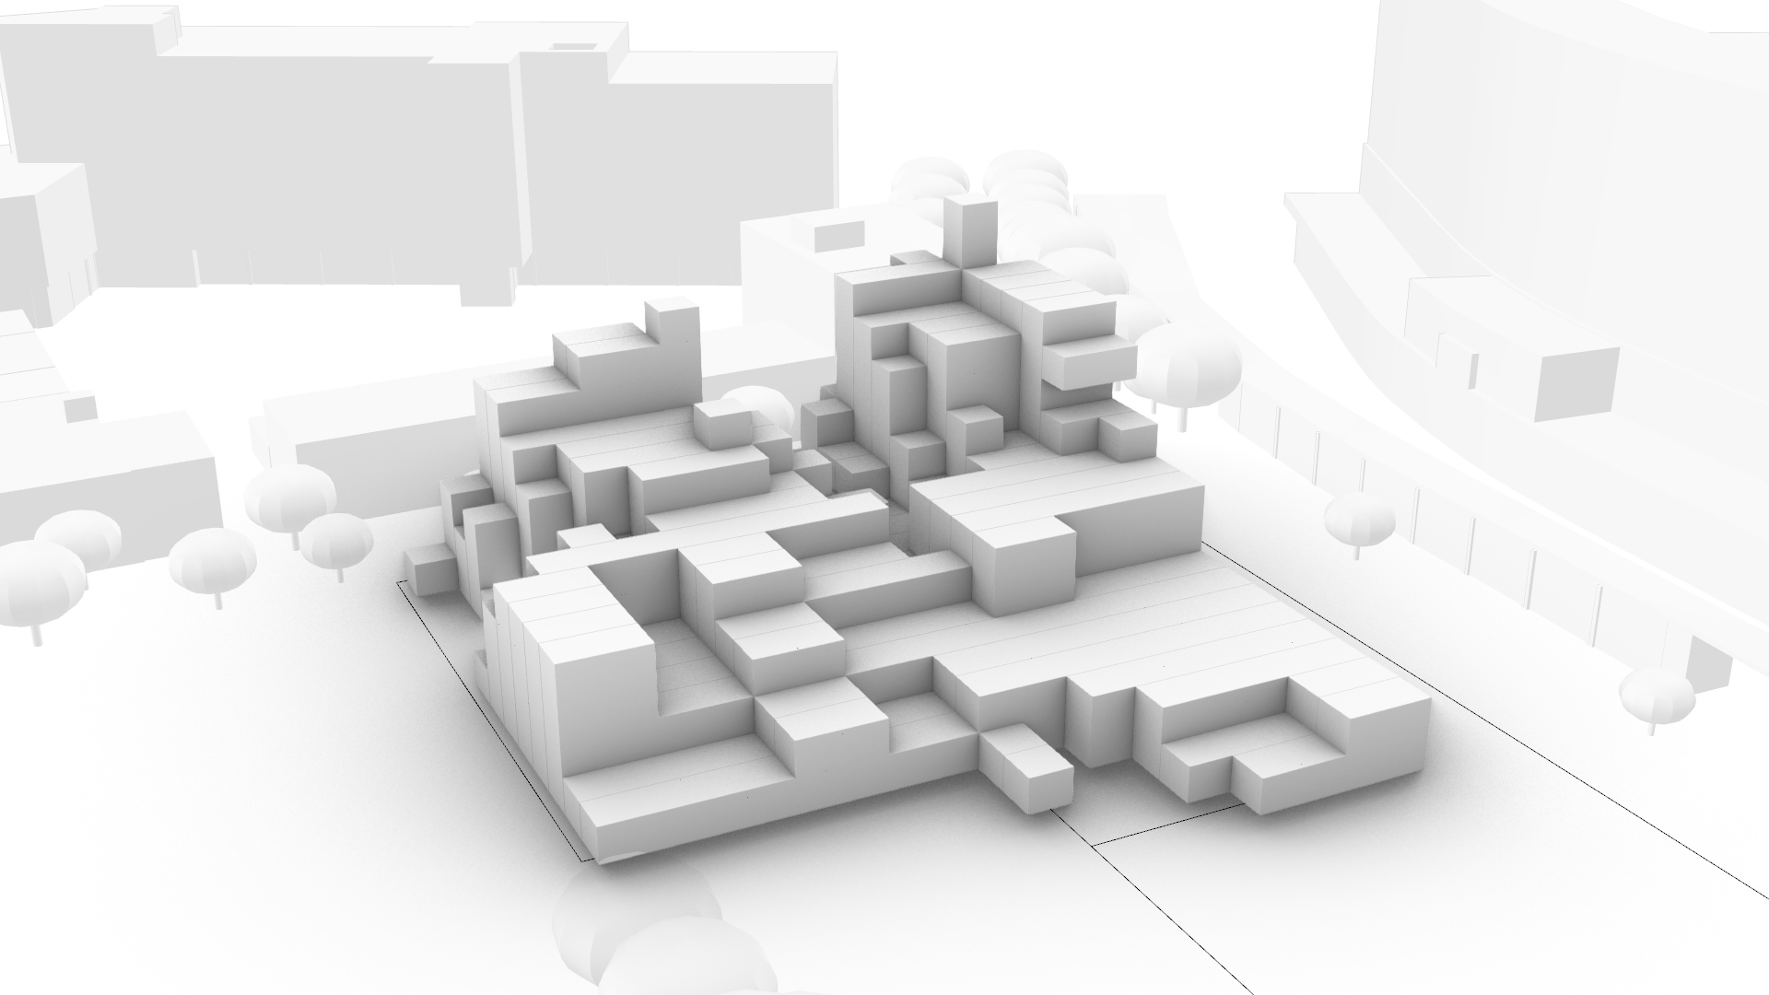
Overview of the process
Concept of the building
Voxelisation of the building plot
Solar envelope
Graph relaxation
Noise analysis
Shadow analysis
Function analysis
Growing algorithm
Design
Path finding algorithm

Slide 20
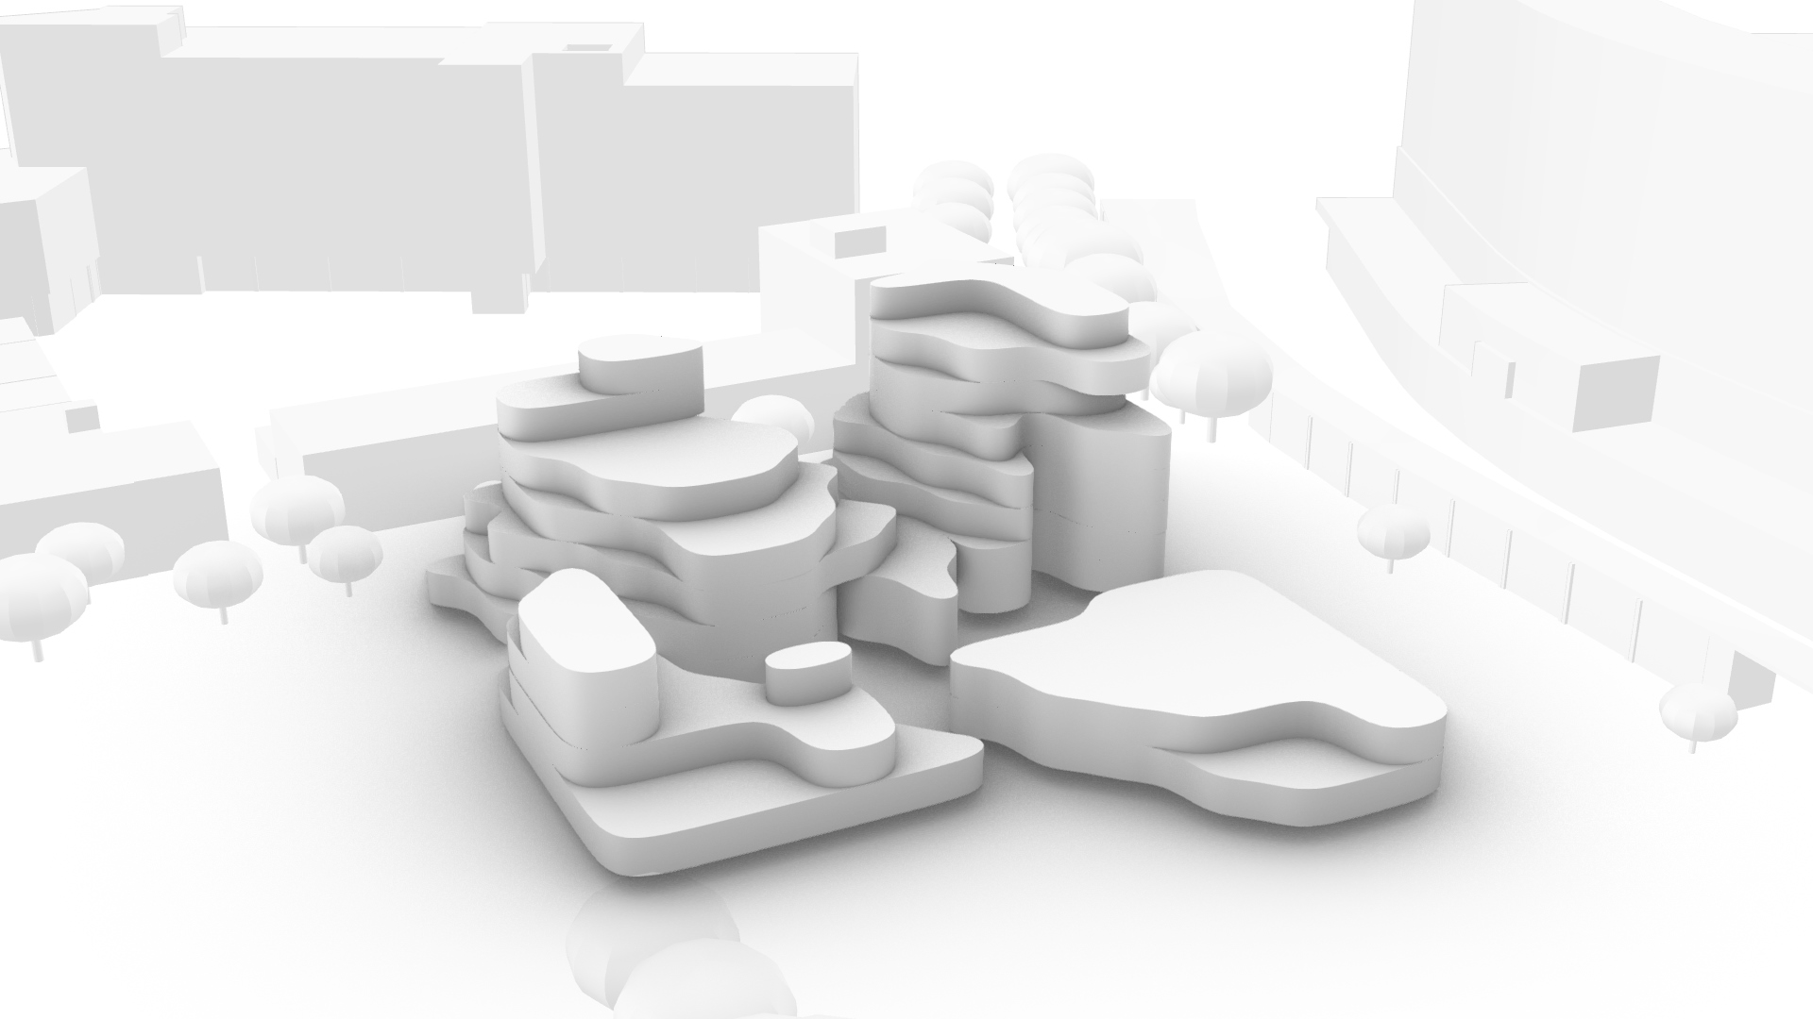
Overview of the process
Concept of the building
Voxelisation of the building plot
Solar envelope
Graph relaxation
Noise analysis
Shadow analysis
Function analysis
Growing algorithm
Design
Path finding algorithm

Slide 21
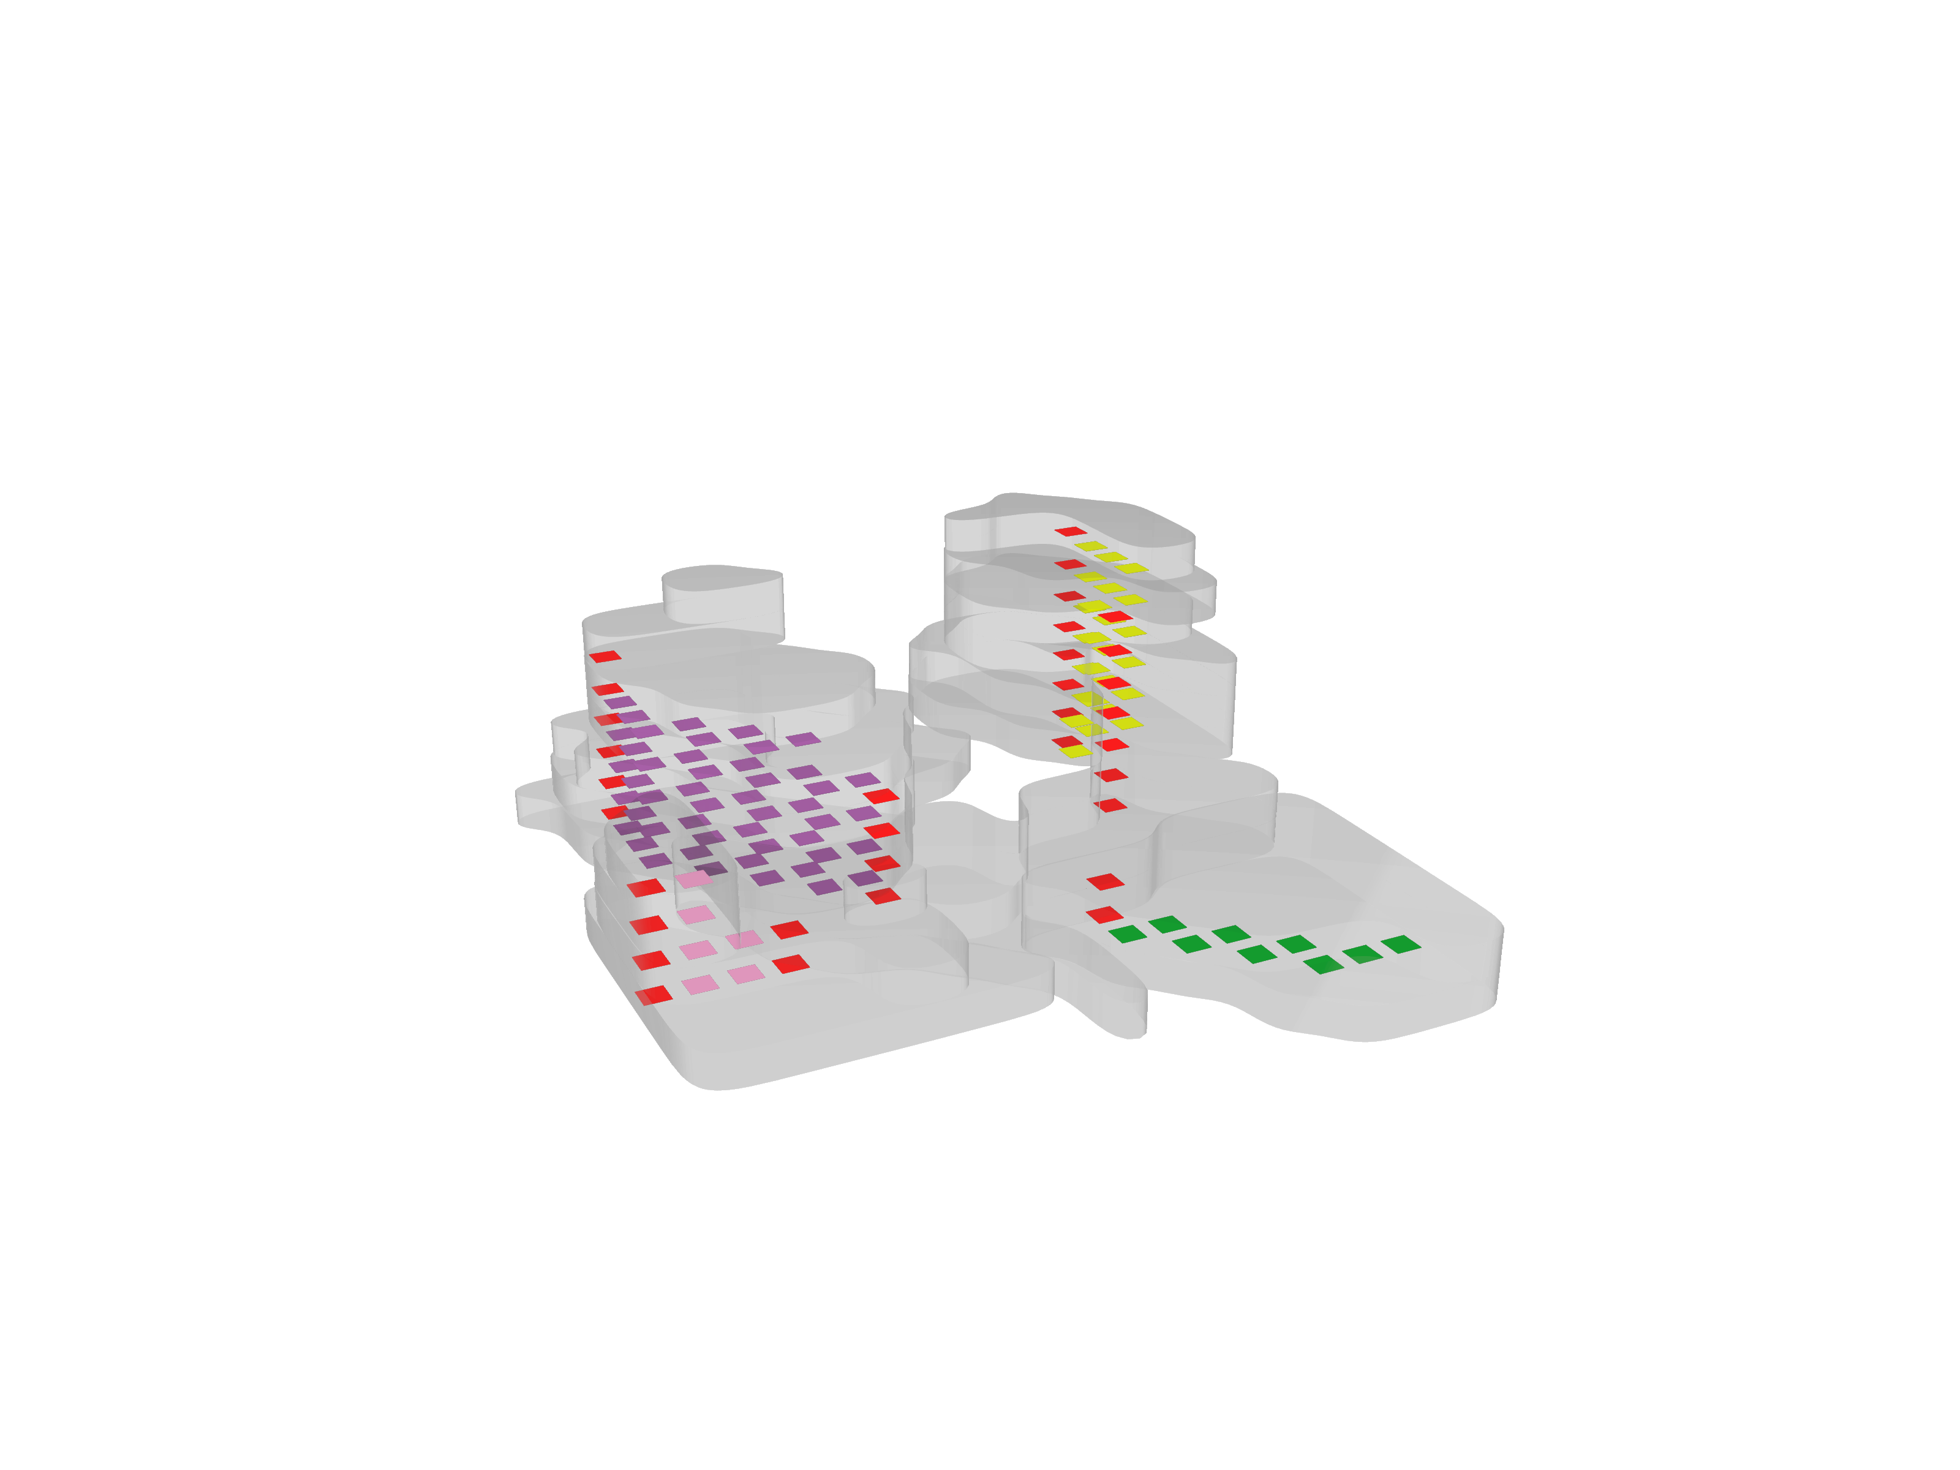
Overview of the process
Concept of the building
Voxelisation of the building plot
Solar envelope
Graph relaxation
Noise analysis
Shadow analysis
Function analysis
Growing algorithm
Design
Path finding algorithm

Slide 22
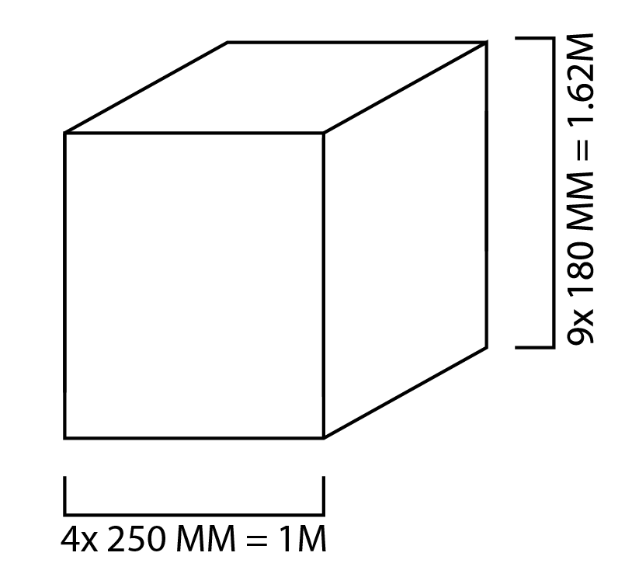
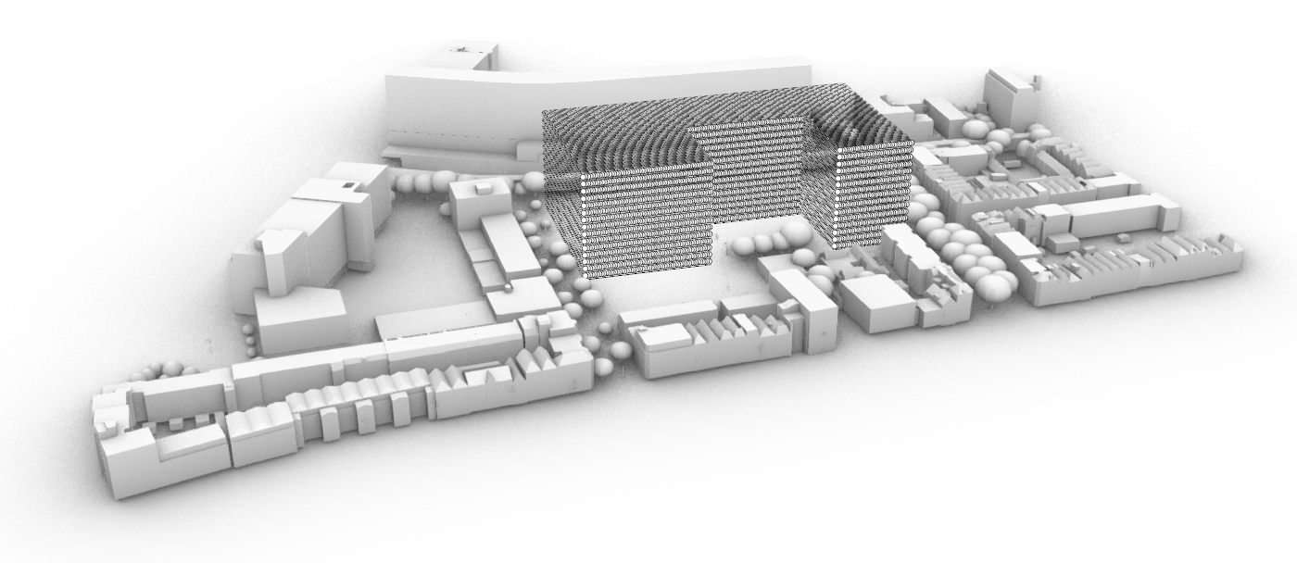
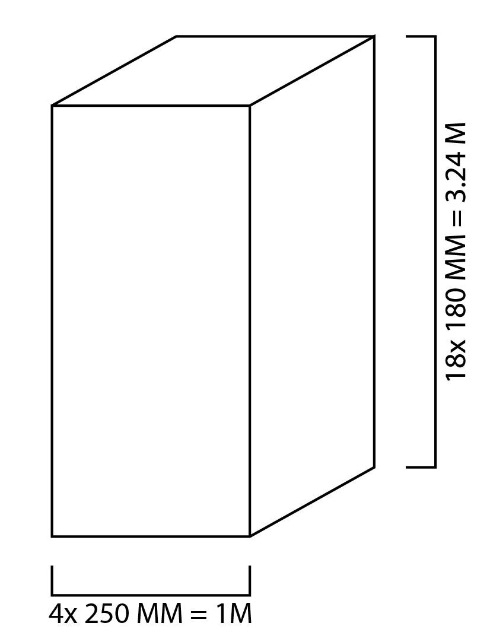
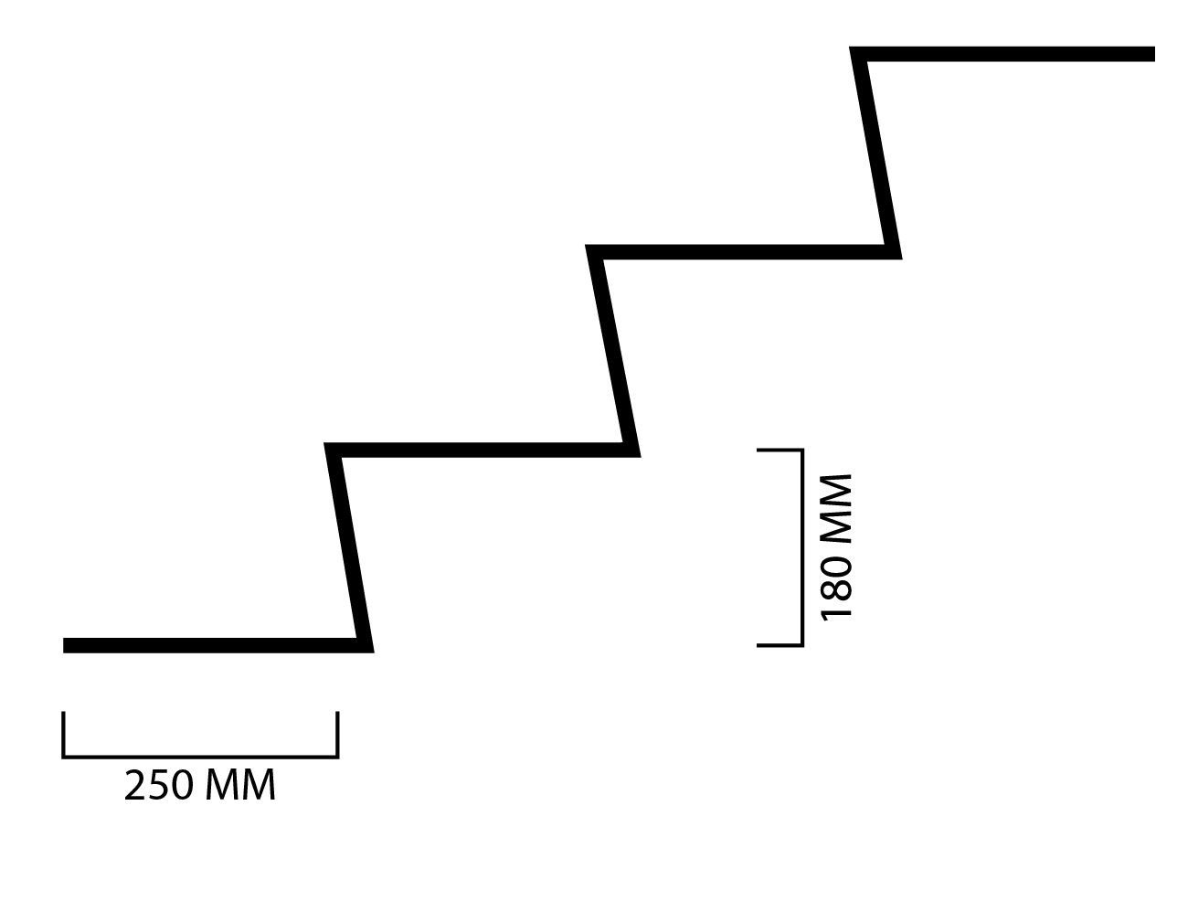
Voxelisation of the building plot
Voxel size: 1m x 1m x 3.24m

Slide 23
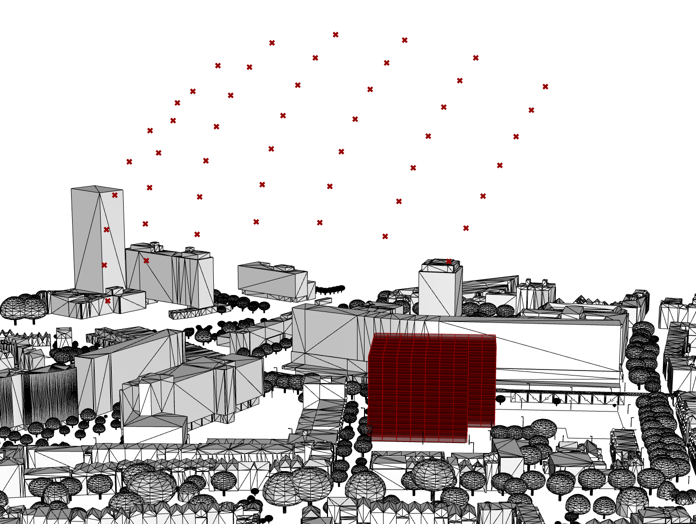
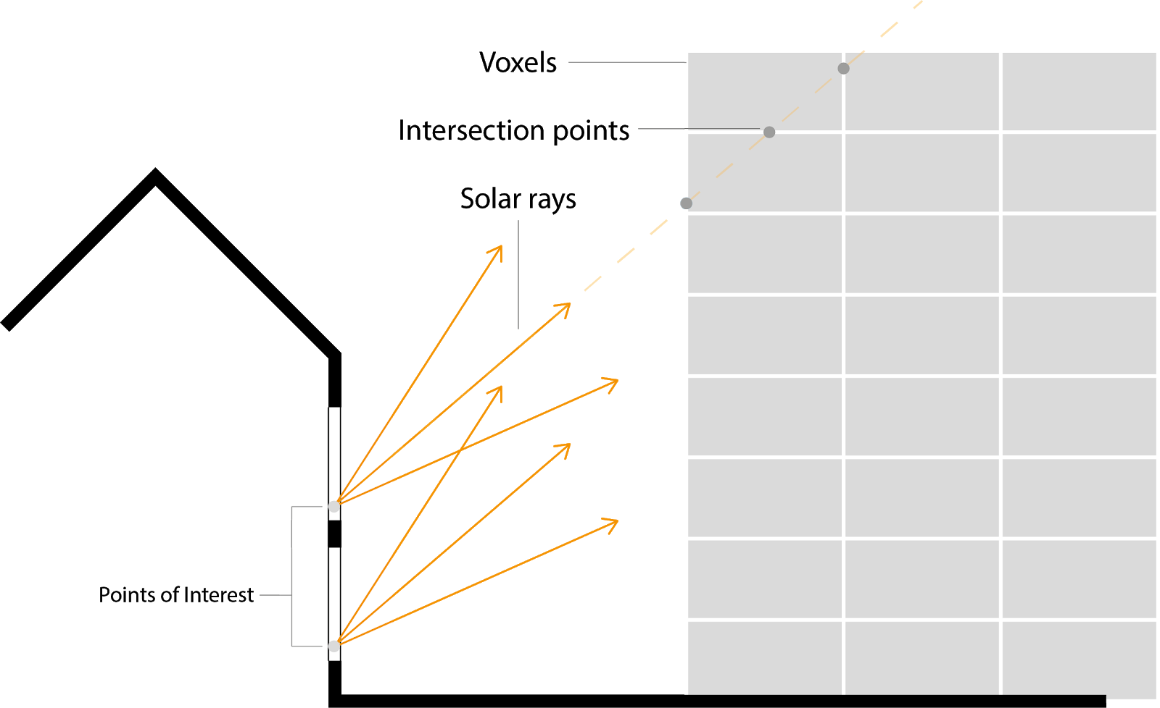
Solar envelope

Slide 24
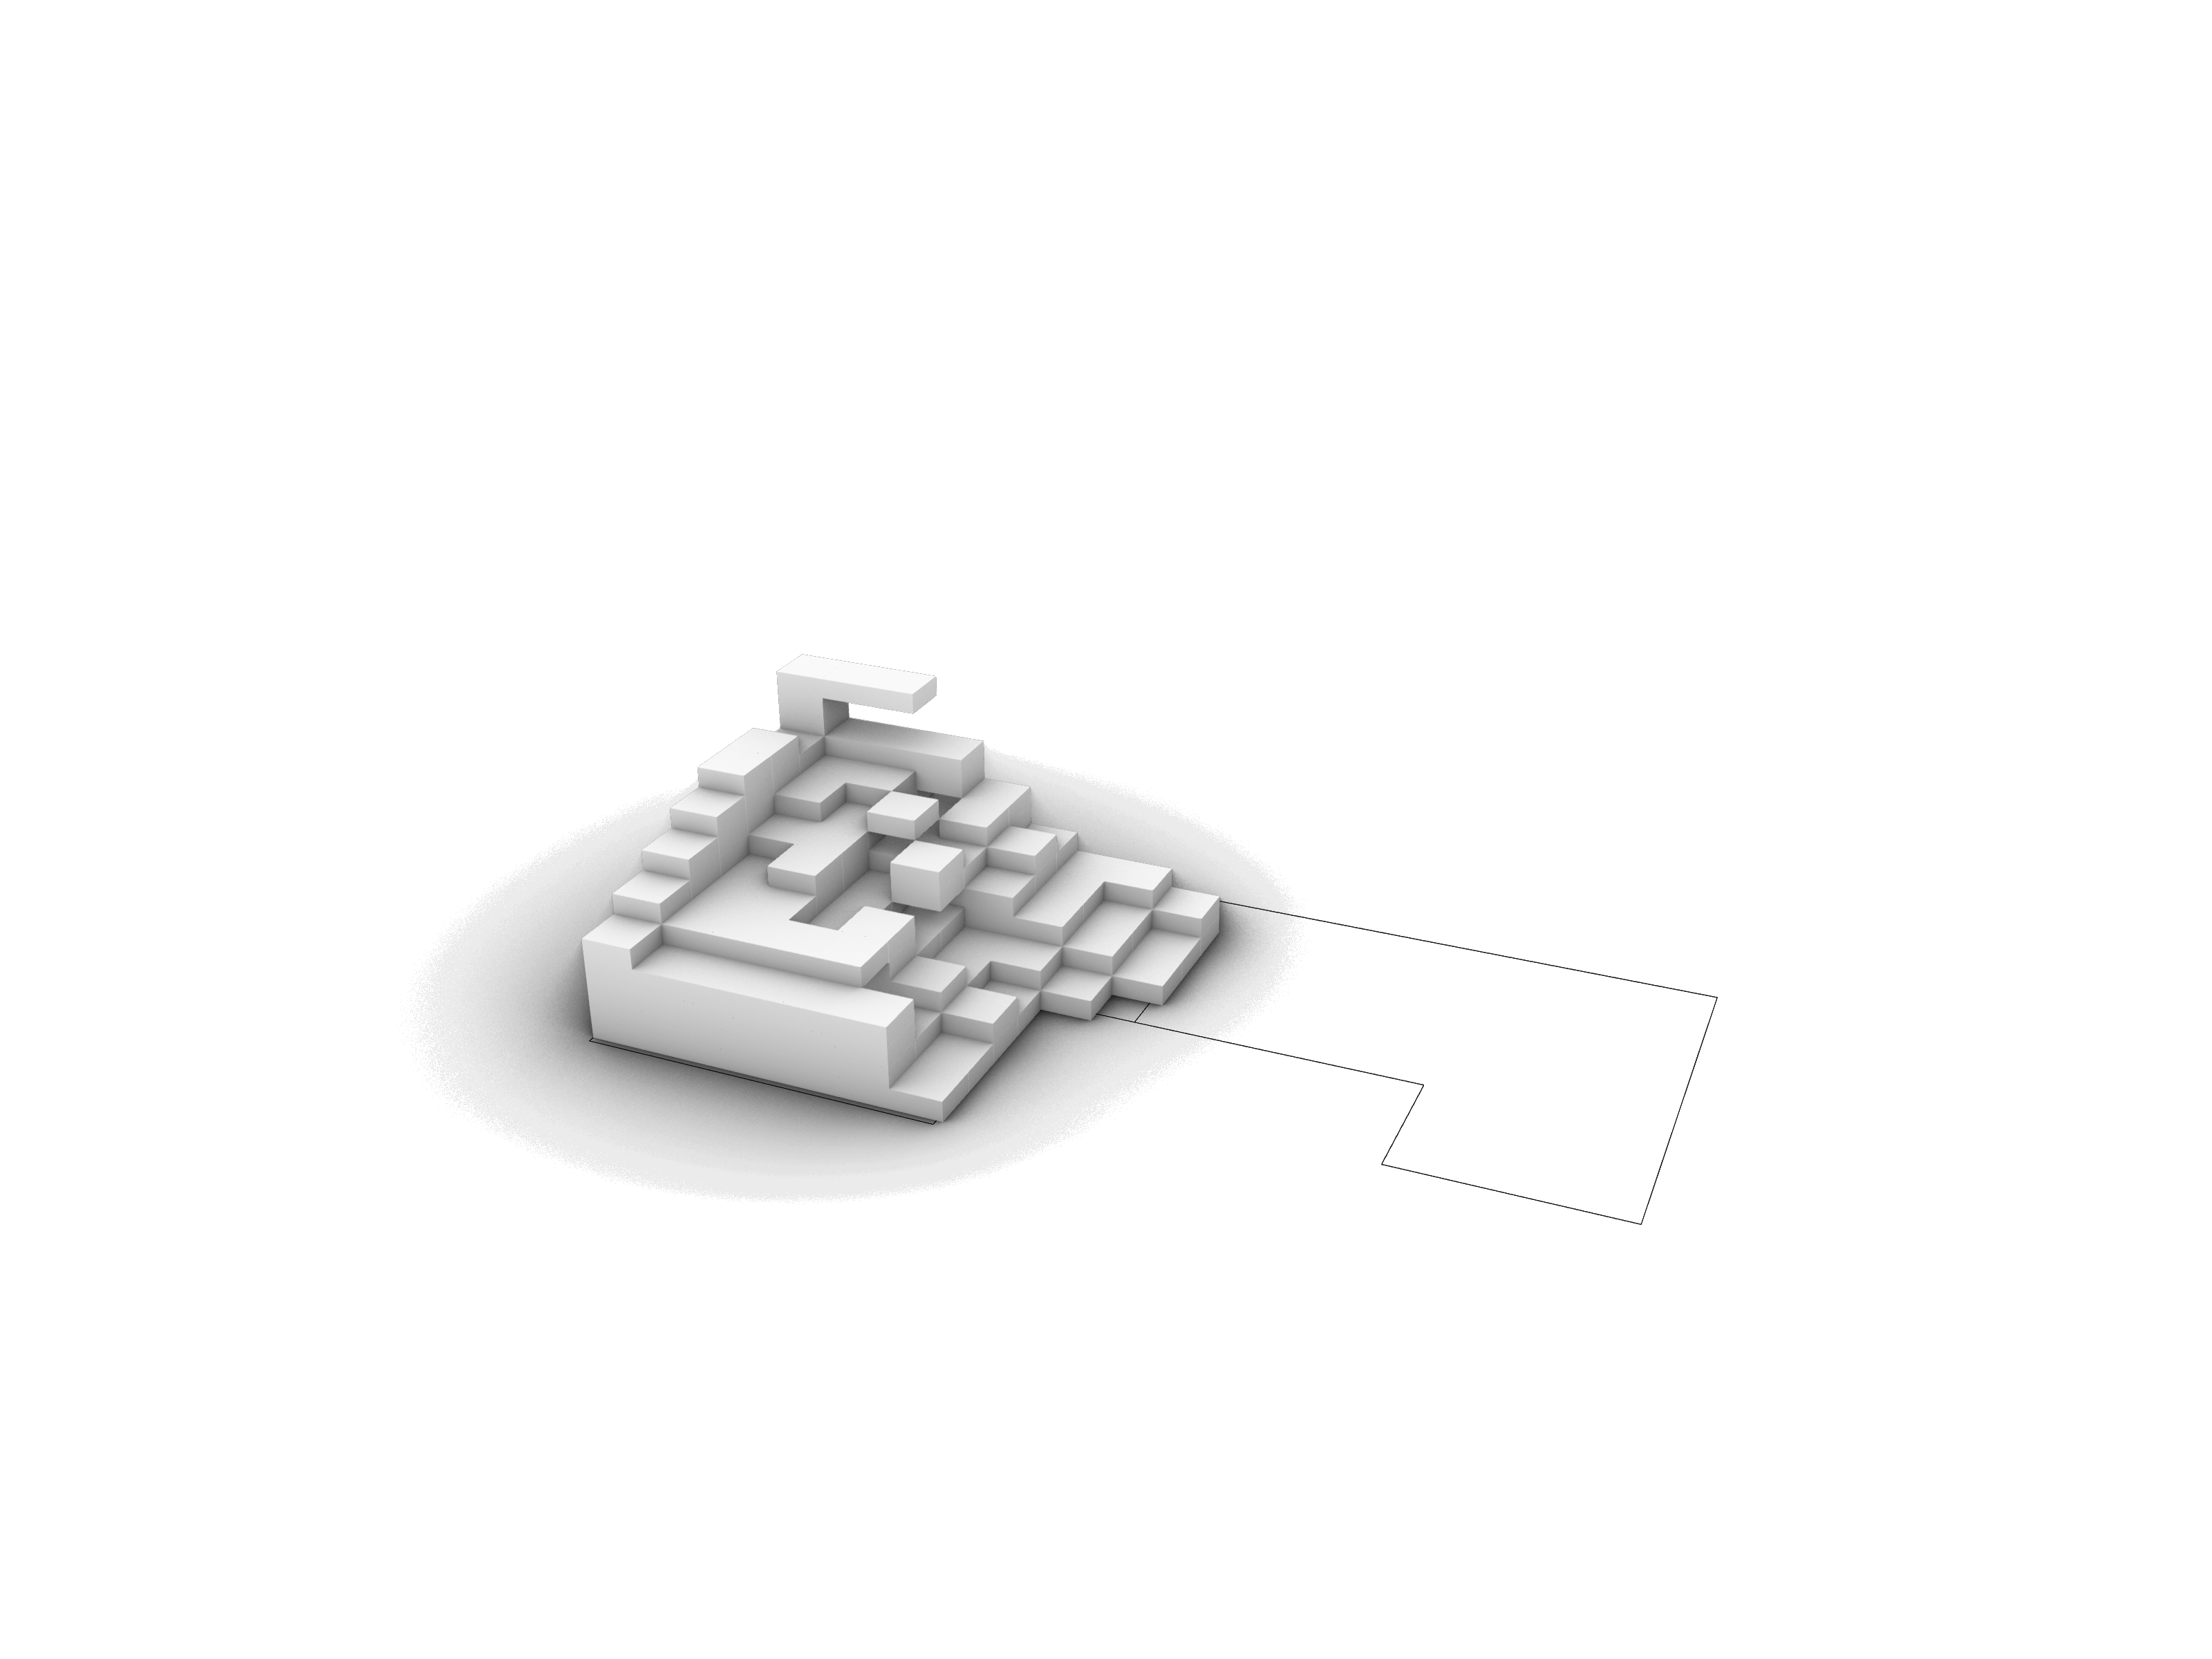
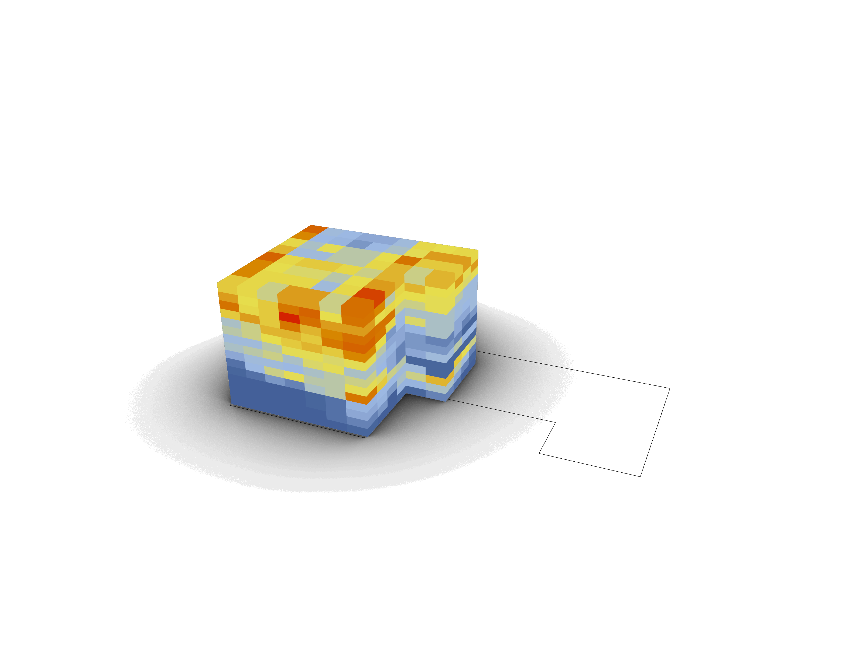
Solar envelope

Slide 25
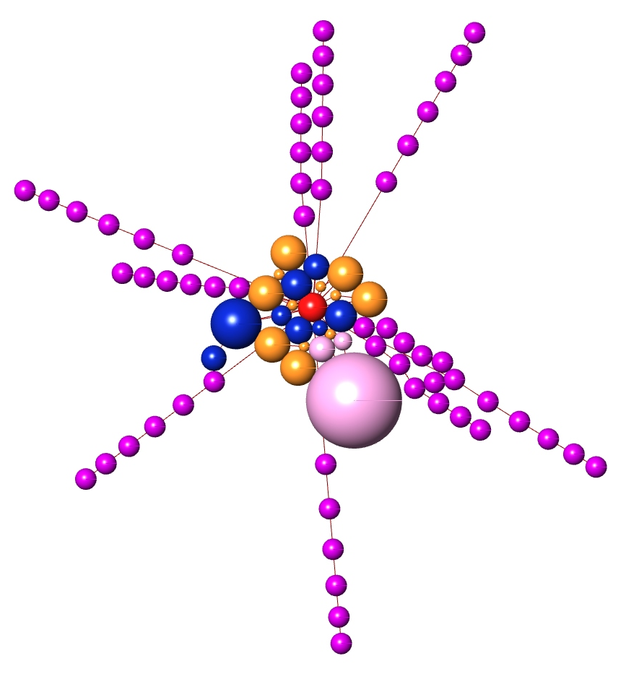
Graph relaxation
Atrium
Student housing
Assisted living
Starter housing
Public functions

Slide 26
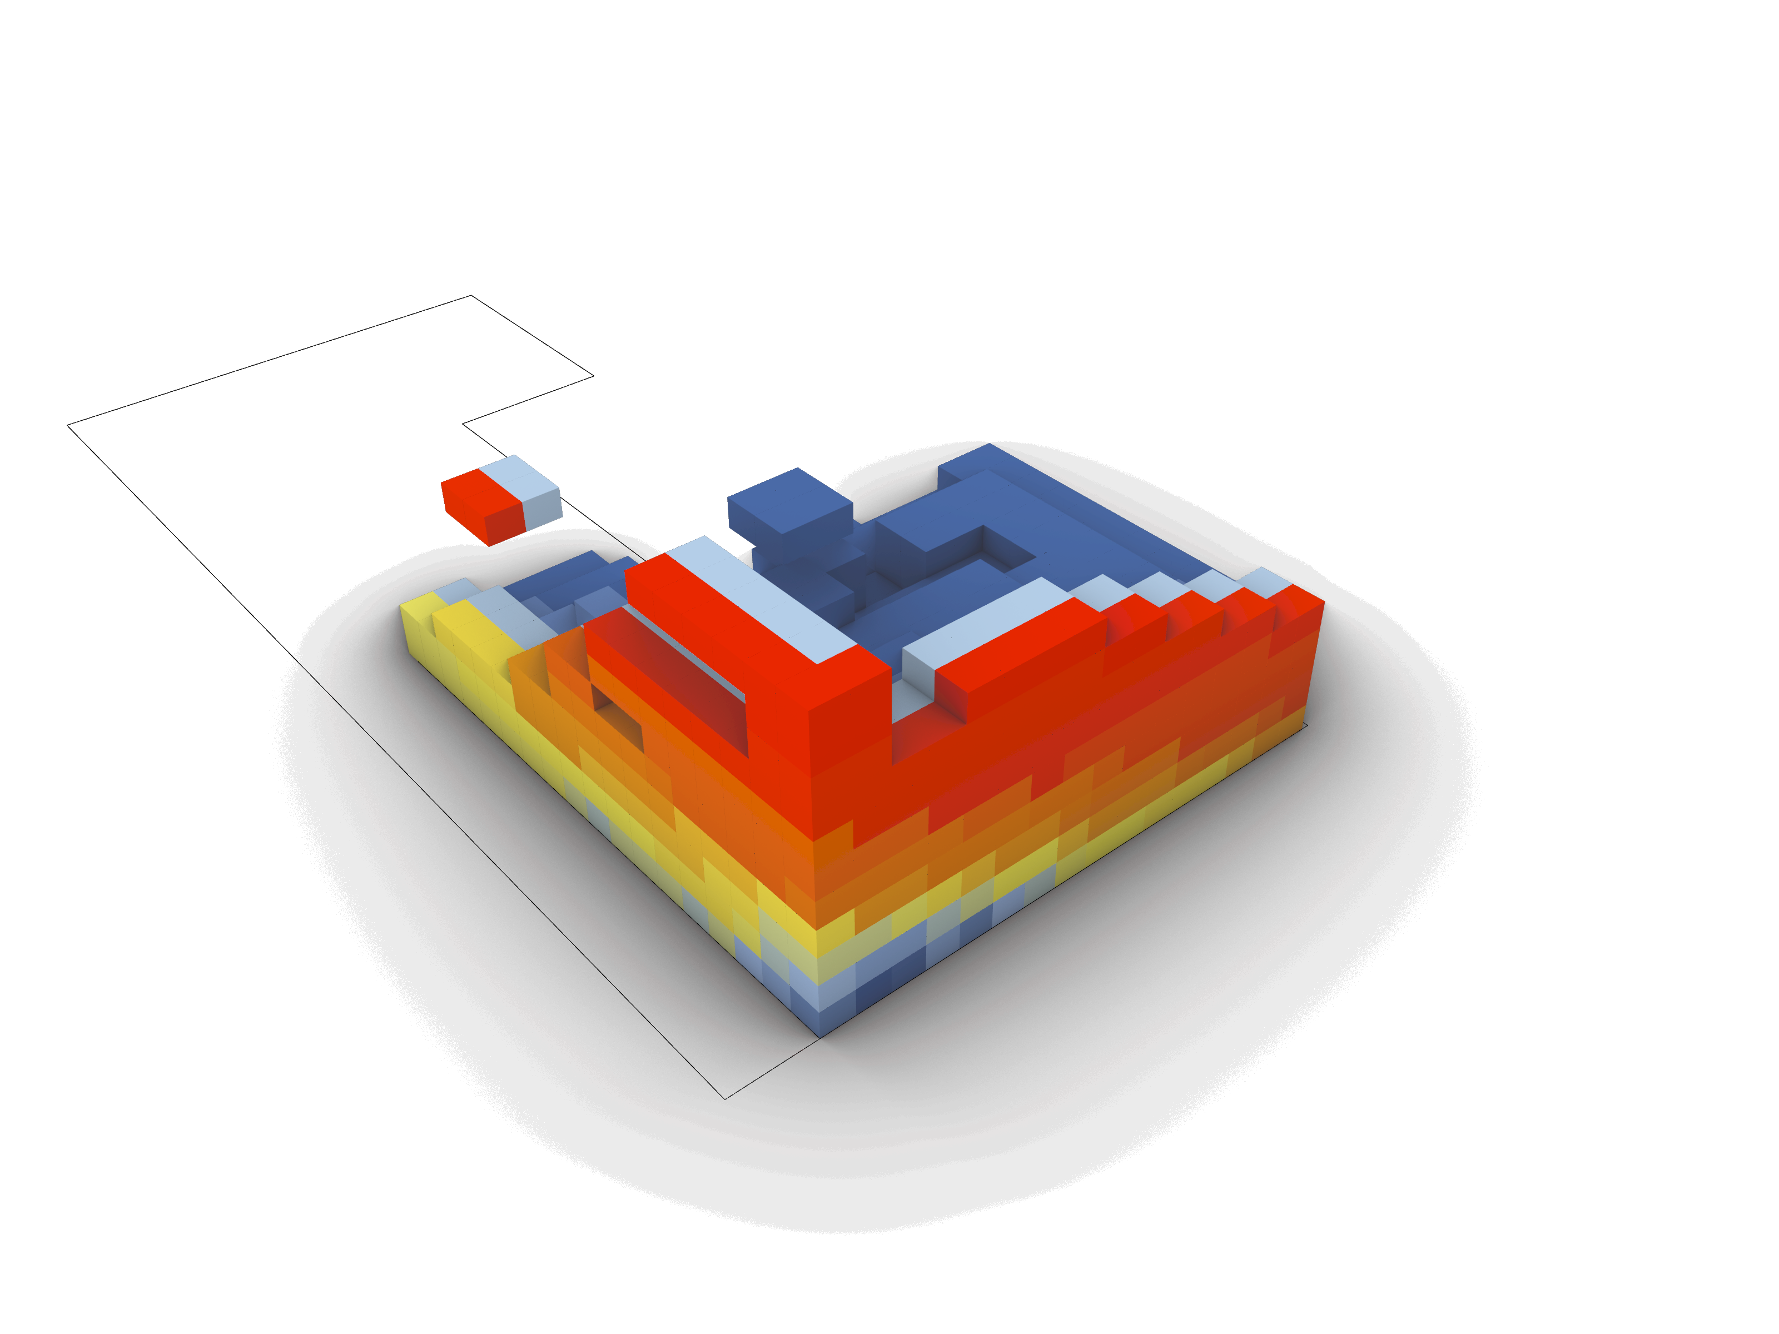
Shadow analysis
For every voxel:
Get the centerpoint
Draw a reversed solar ray from the centerpoint
Intersect solar ray with environment
Count how many times the ray intersects
Output: amount of hits indicating how many times the sun was blocked for each voxel

Slide 27
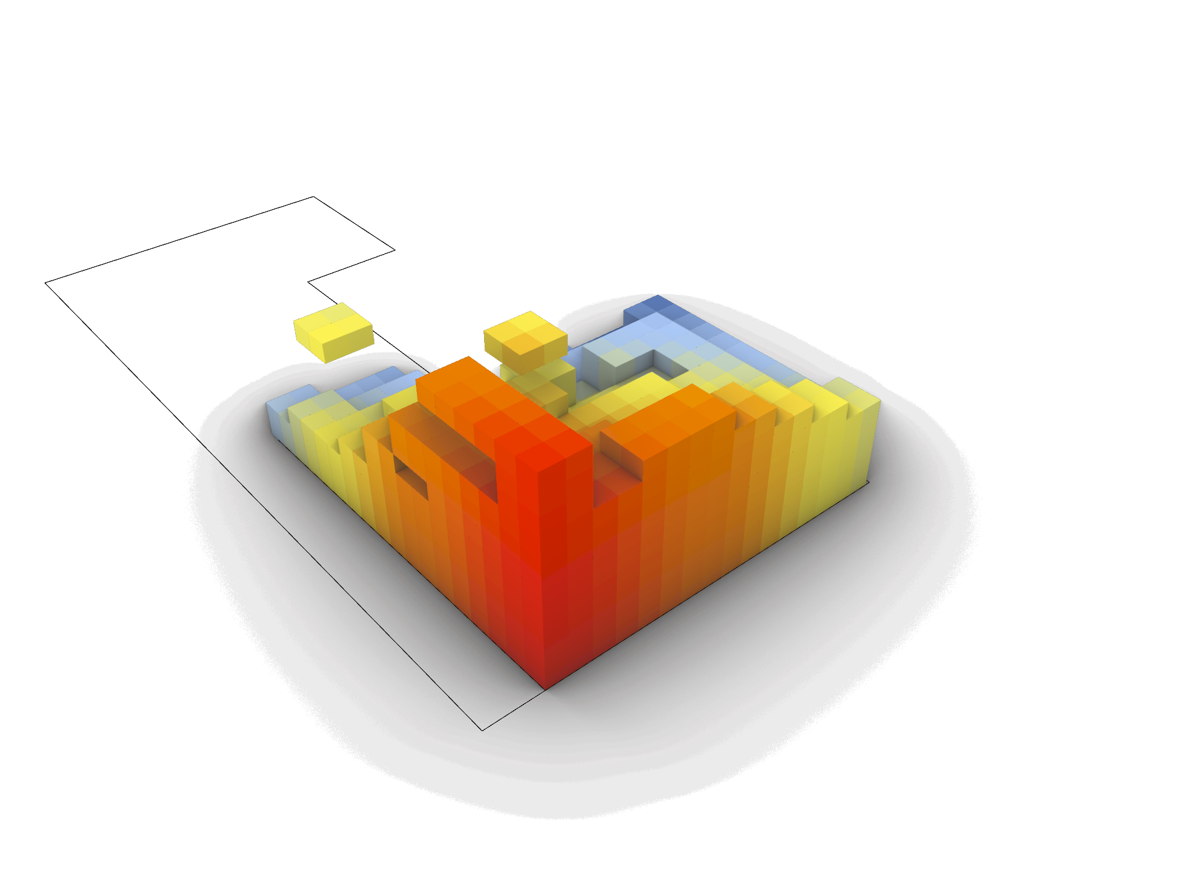
Noise analysis
For every voxel:
Get the centerpoint
Calculate distance between point and source of sound
Output: list of distances
Higher distance = less noise disturbance

Slide 28
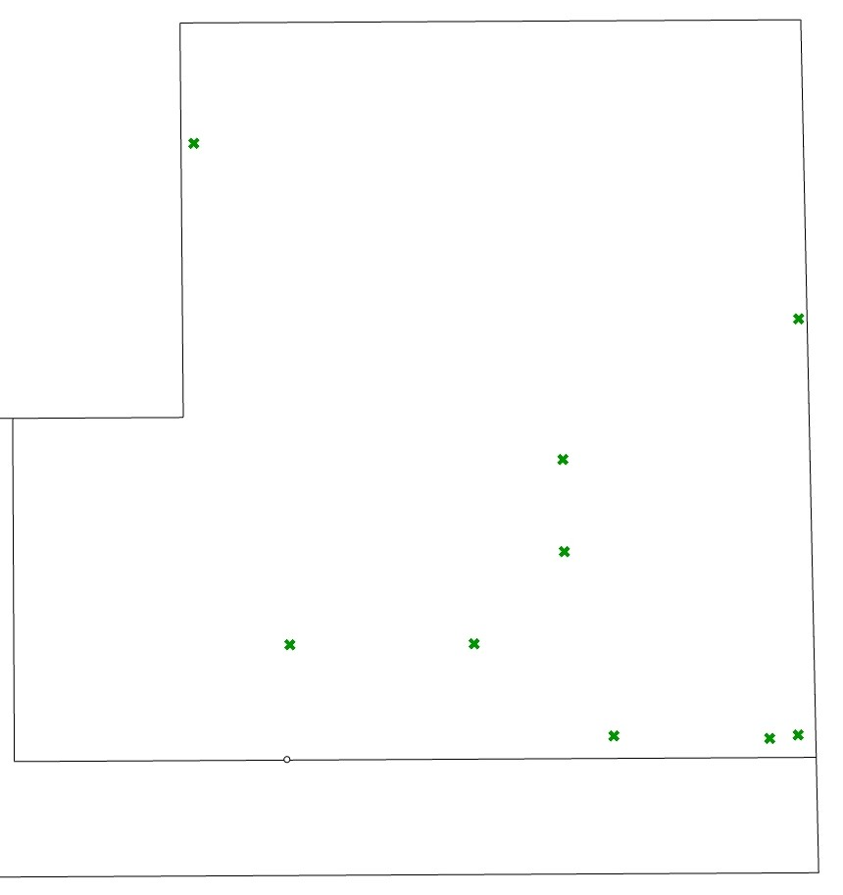
Growing Algorithm: pseudocode
Input:
indices of the starting points of the functions (placed according to the graph relaxation)
integer x, y and z coordinates of the pointcloud left over after the solar envelope
noise- (and shadow-) values for each point in the pointcloud

Slide 29
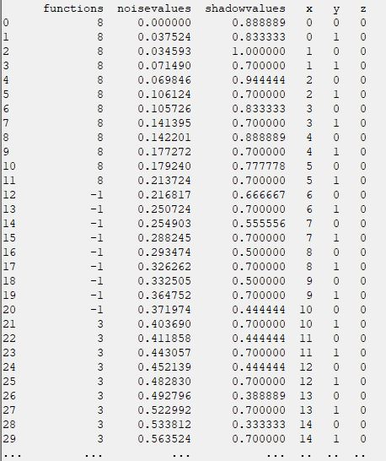
Growing Algorithm: pseudocode
Algorithm:
define the characteristics of each function in the building (maximum surface, maximum shadow value and minimum noise value)
create a panda dataframe with columns for:
the x-, y-, z-coordinates
the noise value of each point in the pointcloud
the shadow value of each point in the pointcloud
label of the function that the point belongs to (-1 = no function, to start with)

Slide 30
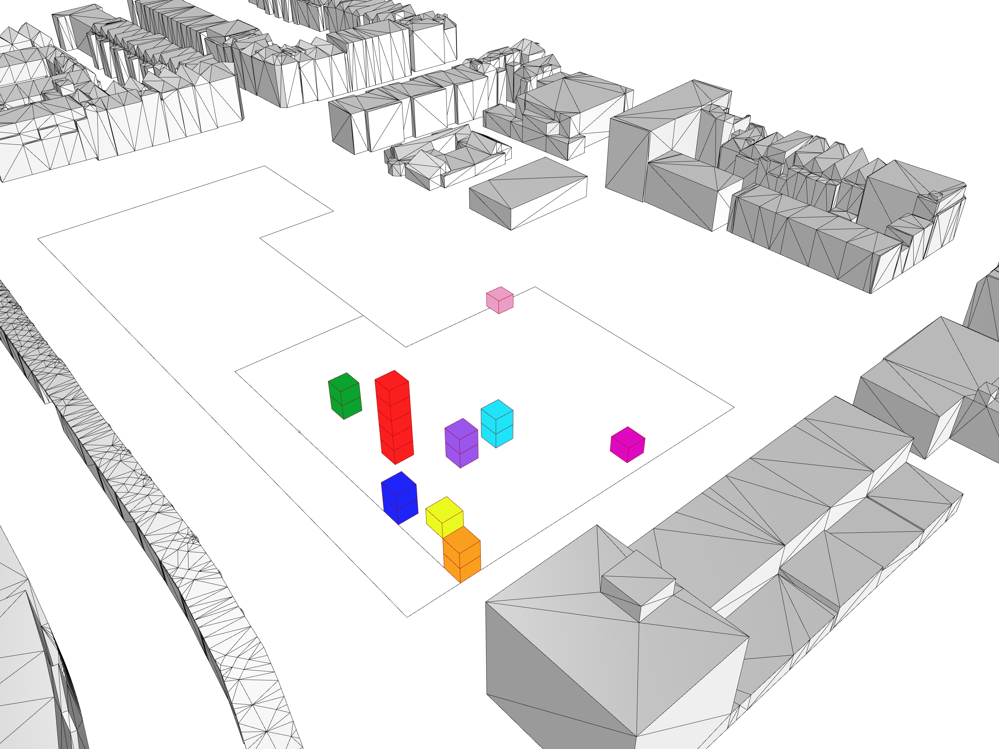
Growing Algorithm: pseudocode
for all the starting points: set the label in the 'function' column to the corresponding number (Atrium = 0, student housing = 1, assisted housing = 2, …)
set the labels of the voxels on top of the atrium starting point to 0, as the atrium should reach to the top of the building
set the labels of the voxels just on top of the public function starting points to their corresponding labels, as all the public functions should be double height

Slide 31
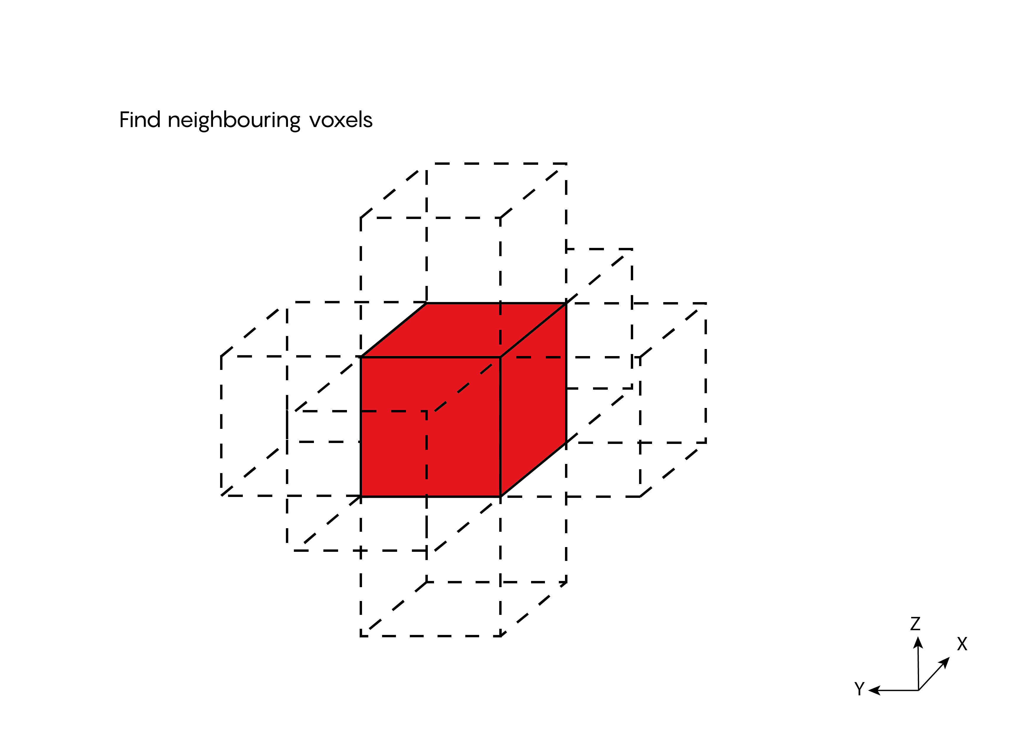
Growing Algorithm: pseudocode
while loop that loops through every growing function until there are no more voxels left over in the building OR until all the maximum surfaces of the functions have been reached
following loop is written for each function in the building:
if statement that checks if a function hasn’t reached its full surface yet
for every voxel currently labeled as ‘function’:

Slide 32
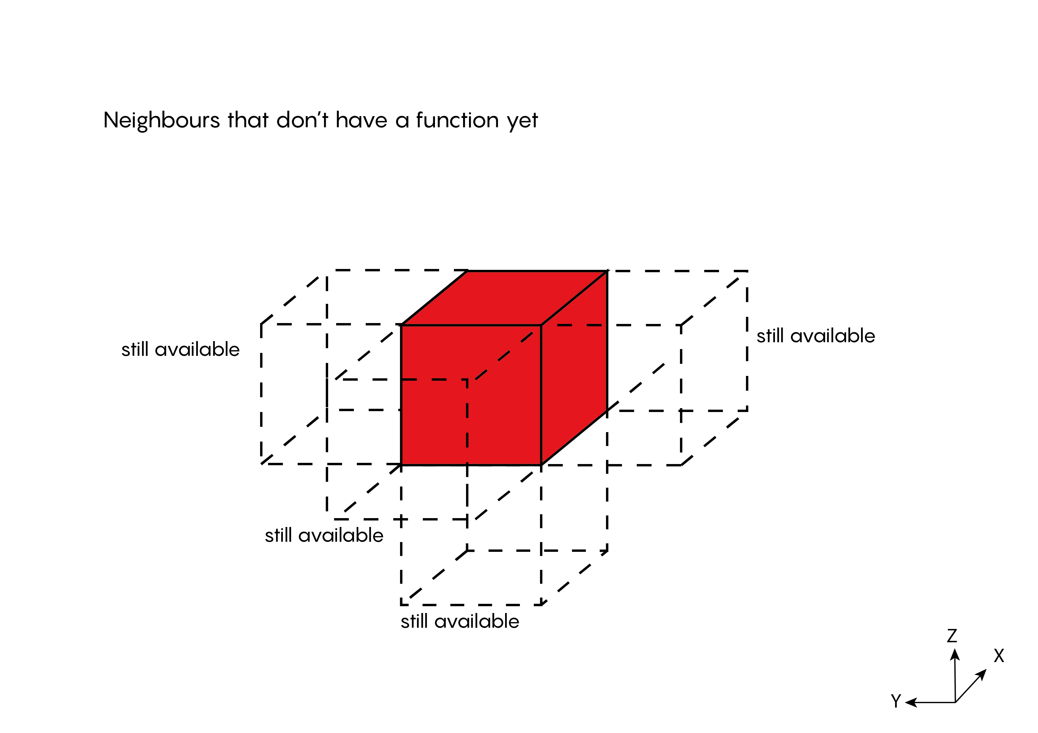
Growing Algorithm: pseudocode
while loop that loops through every growing function until there are no more voxels left over in the building OR until all the maximum surfaces of the functions have been reached
following loop is written for each function in the building:
if statement that checks if a function hasn’t reached its full surface yet
for every voxel currently labeled as ‘function’:

Slide 33
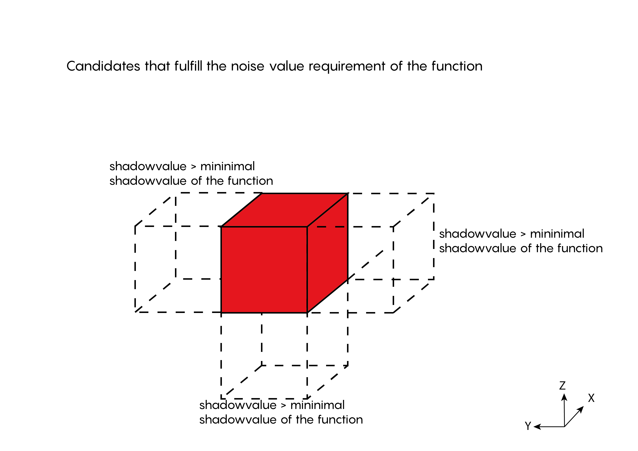
Growing Algorithm: pseudocode
while loop that loops through every growing function until there are no more voxels left over in the building OR until all the maximum surfaces of the functions have been reached
following loop is written for each function in the building:
if statement that checks if a function hasn’t reached its full surface yet
for every voxel currently labeled as ‘function’:

Slide 34
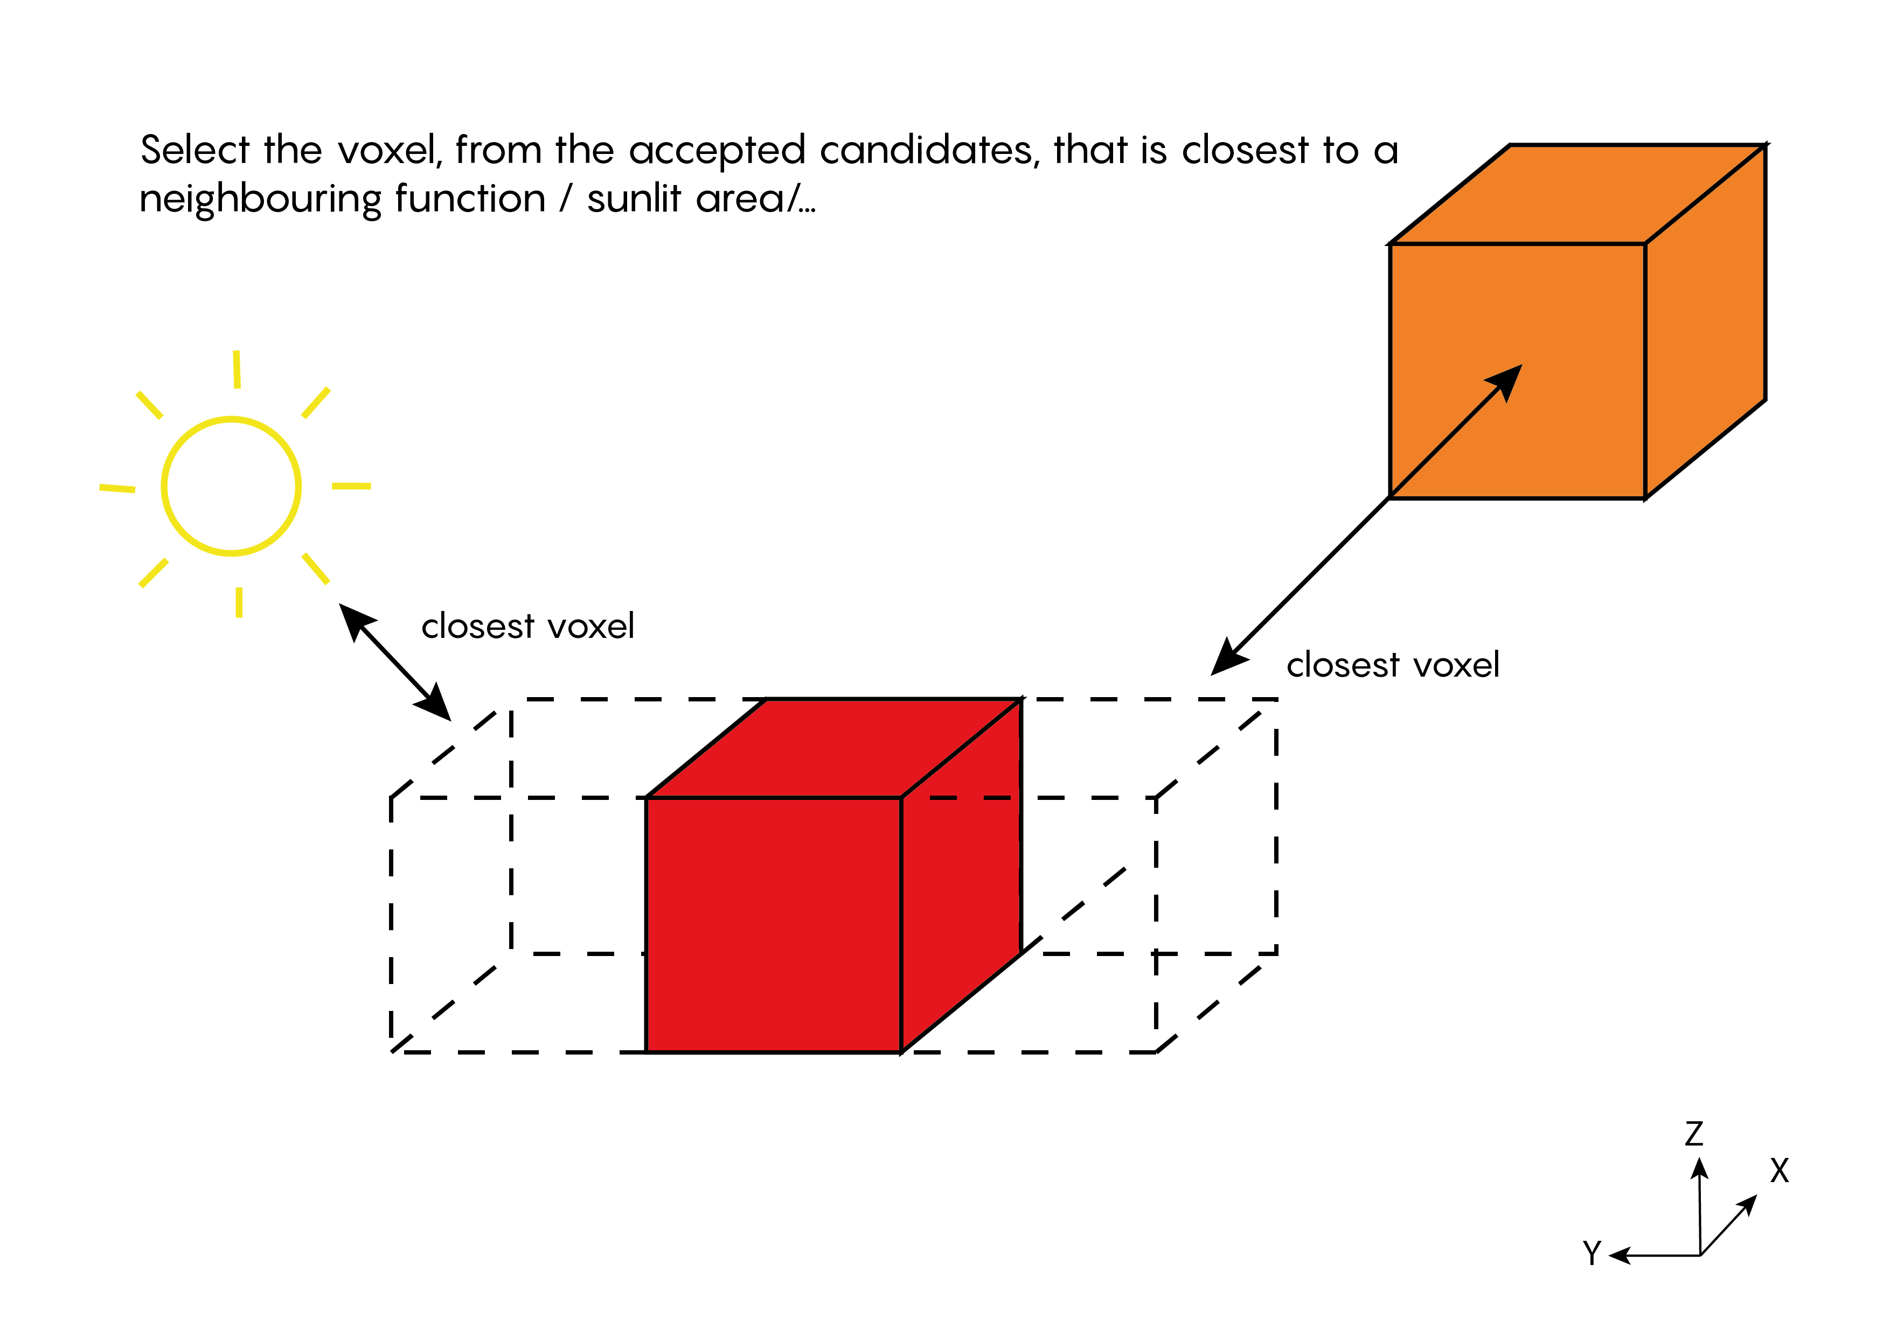
Growing Algorithm: pseudocode
while loop that loops through every growing function until there are no more voxels left over in the building OR until all the maximum surfaces of the functions have been reached
following loop is written for each function in the building:
if statement that checks if a function hasn’t reached its full surface yet
for every voxel currently labeled as ‘function’:

Slide 35
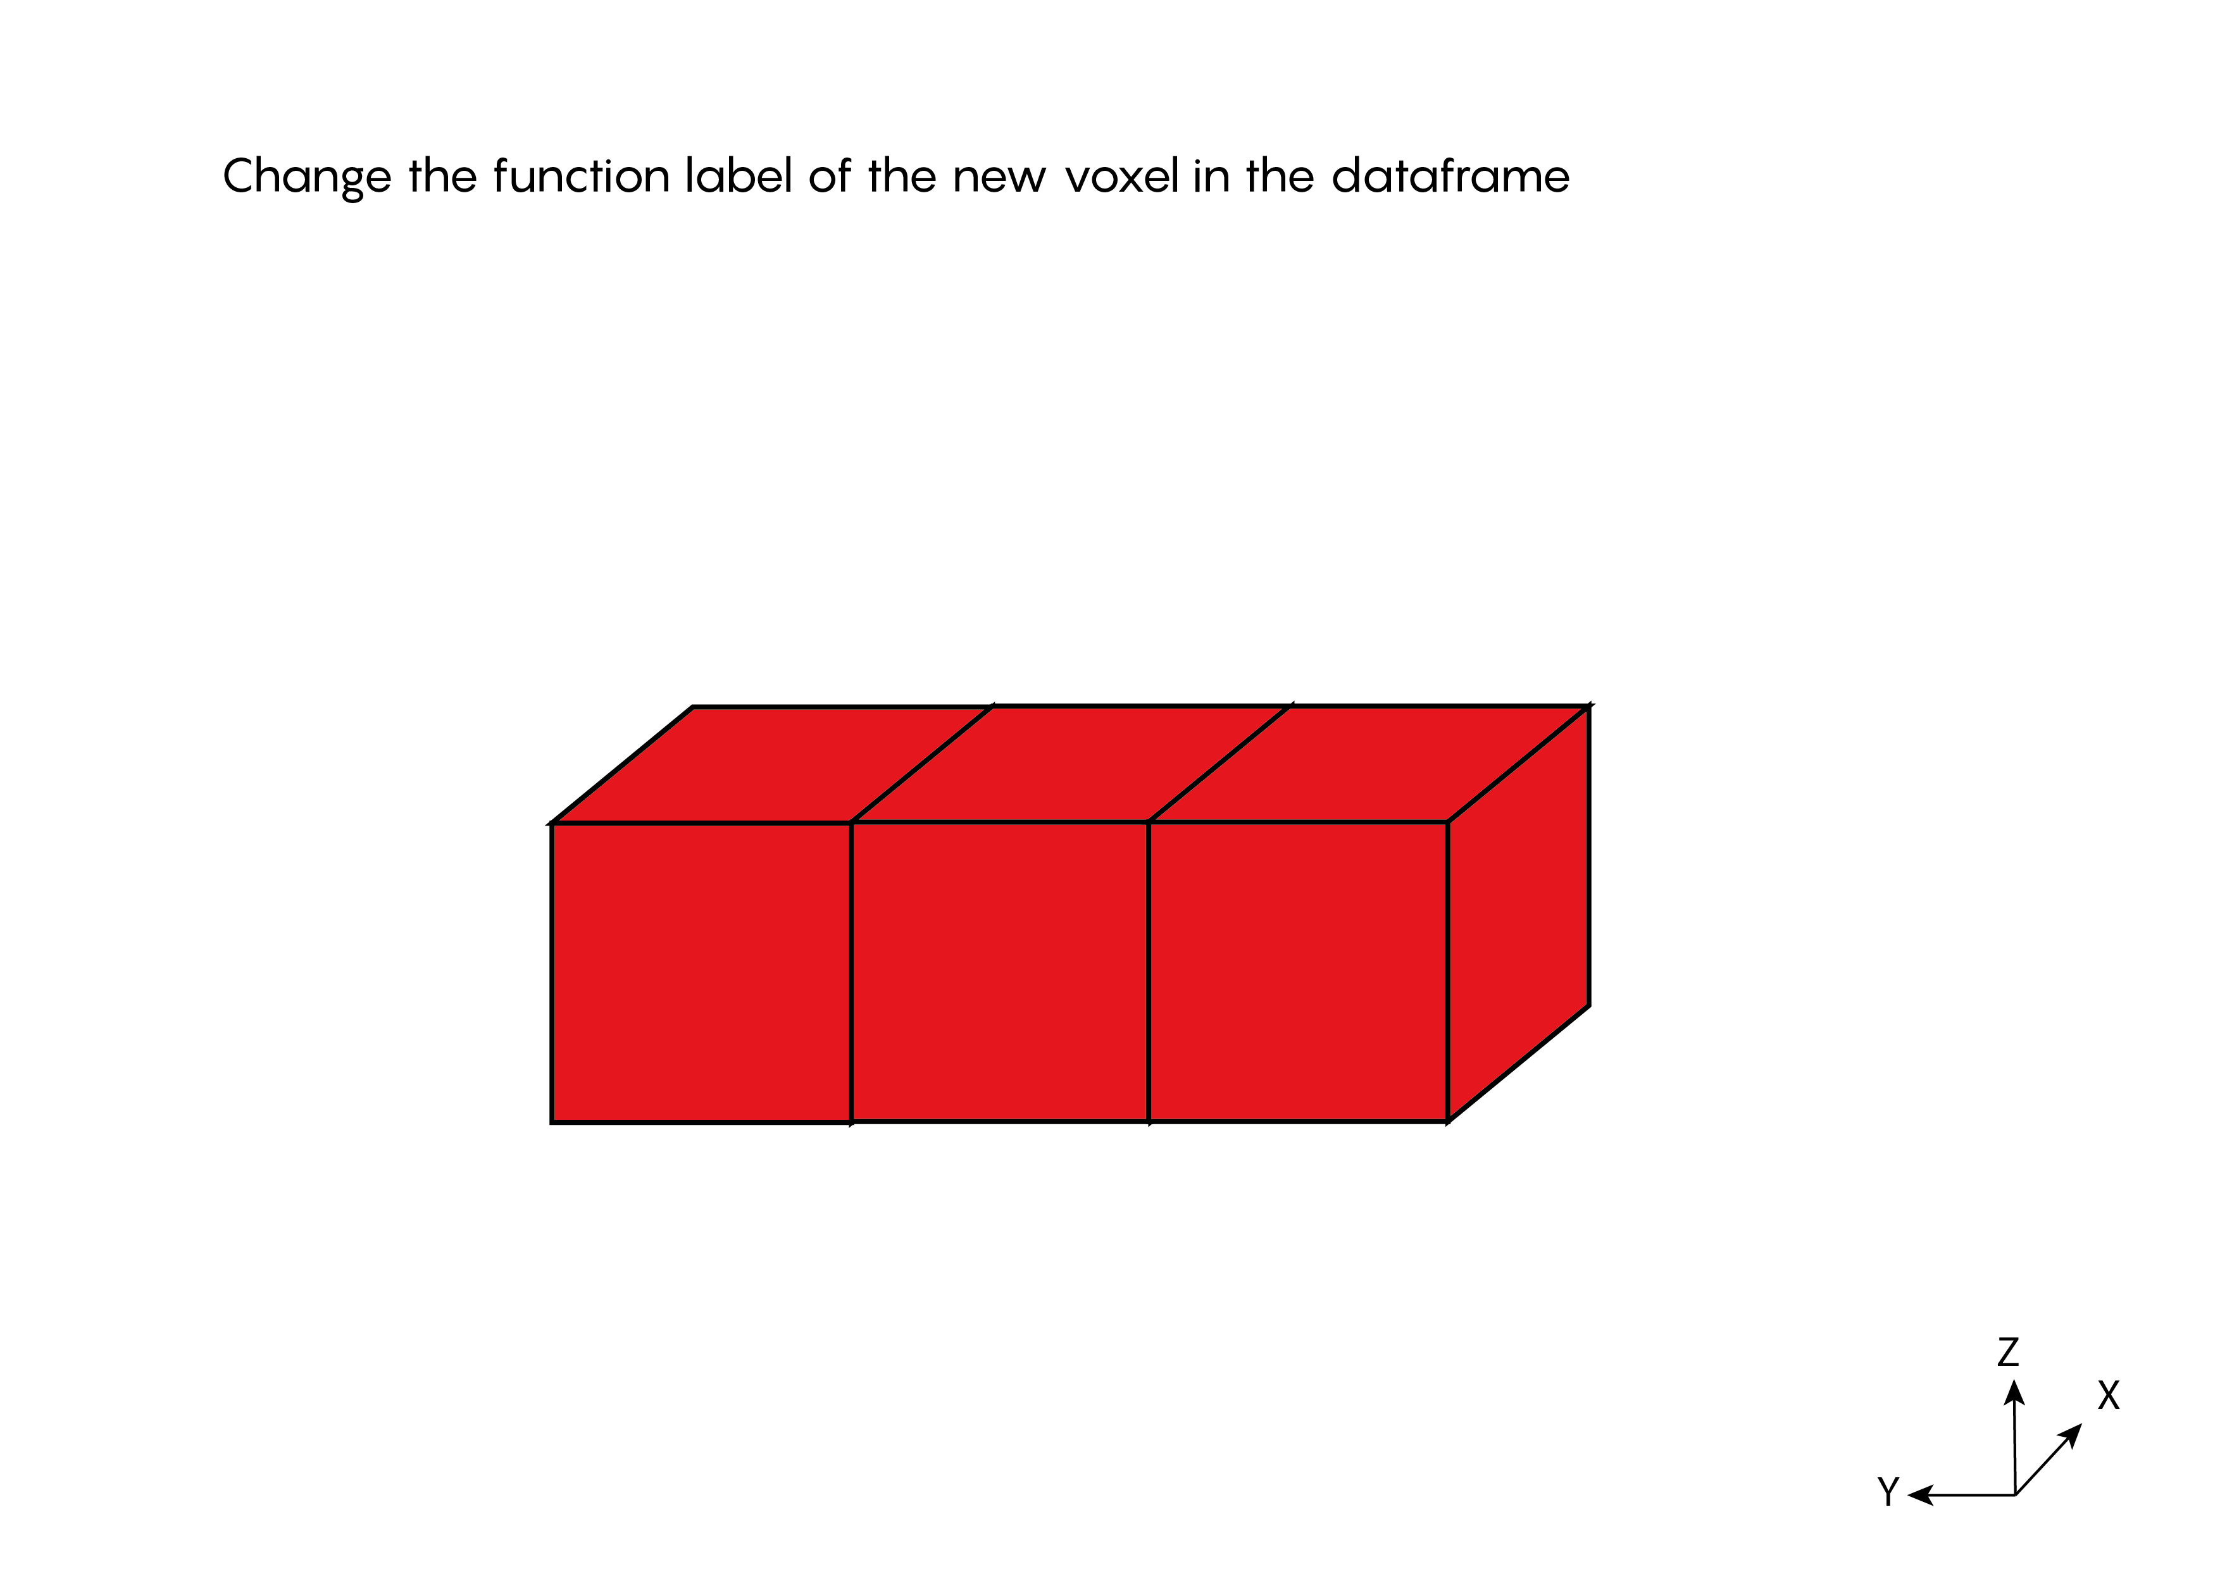
Growing Algorithm: pseudocode
while loop that loops through every growing function until there are no more voxels left over in the building OR until all the maximum surfaces of the functions have been reached
following loop is written for each function in the building:
if statement that checks if a function hasn’t reached its full surface yet
for every voxel currently labeled as ‘function’:

Slide 36
Growing Algorithm: pseudocode
while loop that loops through every growing function until there are no more voxels left over in the building OR until all the maximum surfaces of the functions have been reached
following loop is written for each function in the building:
if statement that checks if a function hasn’t reached its full surface yet
for every voxel currently labeled as ‘function’:
[see illustrations]
[see illustrations]
[see illustrations]
[see illustrations]
[see illustrations]
if statement that checks if there were any accepted candidates found, if not: print a message that tells you that the growth of this function was interrupted & tell python that this functions is done with growing (functionFull = 1)
if statement that tells python that this function is done with growing if the maximum surface has been reached (functionFull = 1)
at the end of the while loop: create a counter that checks if there a still voxels left without a function so that there is still the ability to grow
check how tall the functions have grown around the atrium and take away the voxels of the atrium above that certain level
create lists of the index numbers of the voxels in each function

Slide 37
Growing Algorithm: pseudocode
Output:
lists with indices of the voxels in each function

Slide 38
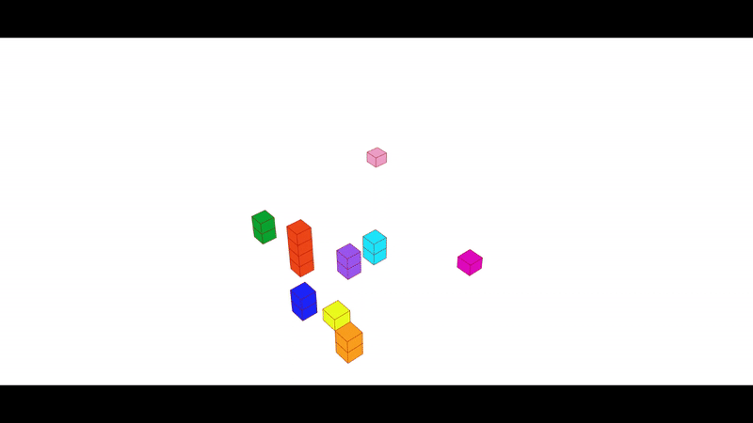
Growing Algorithm

Slide 39
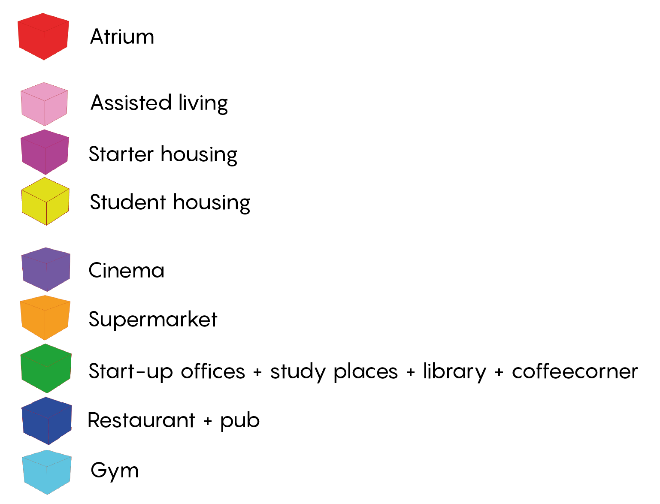
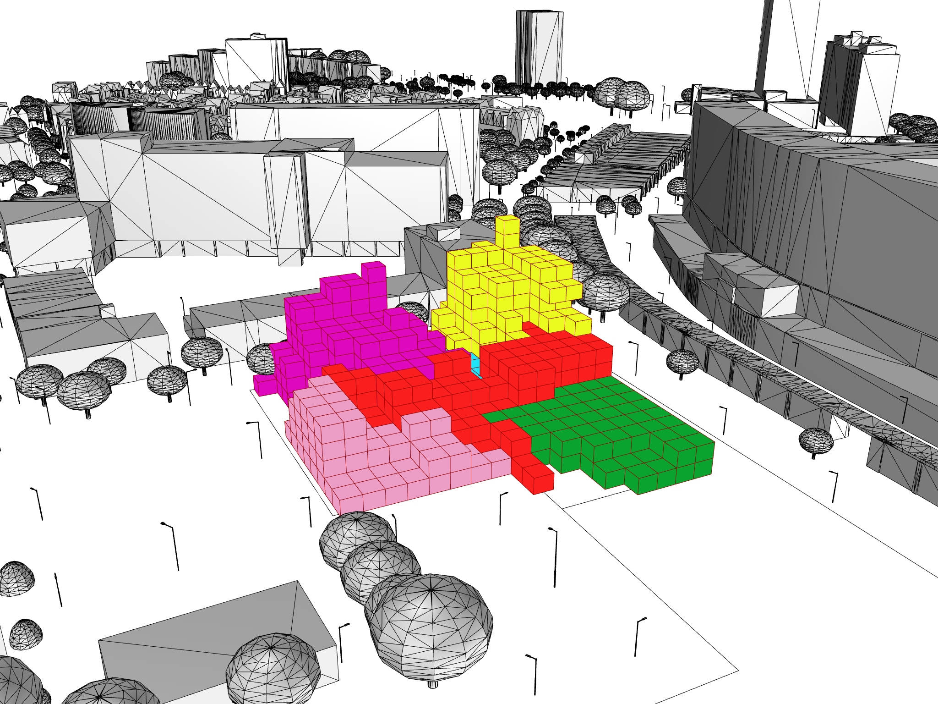
Growing Algorithm: final result

Slide 40
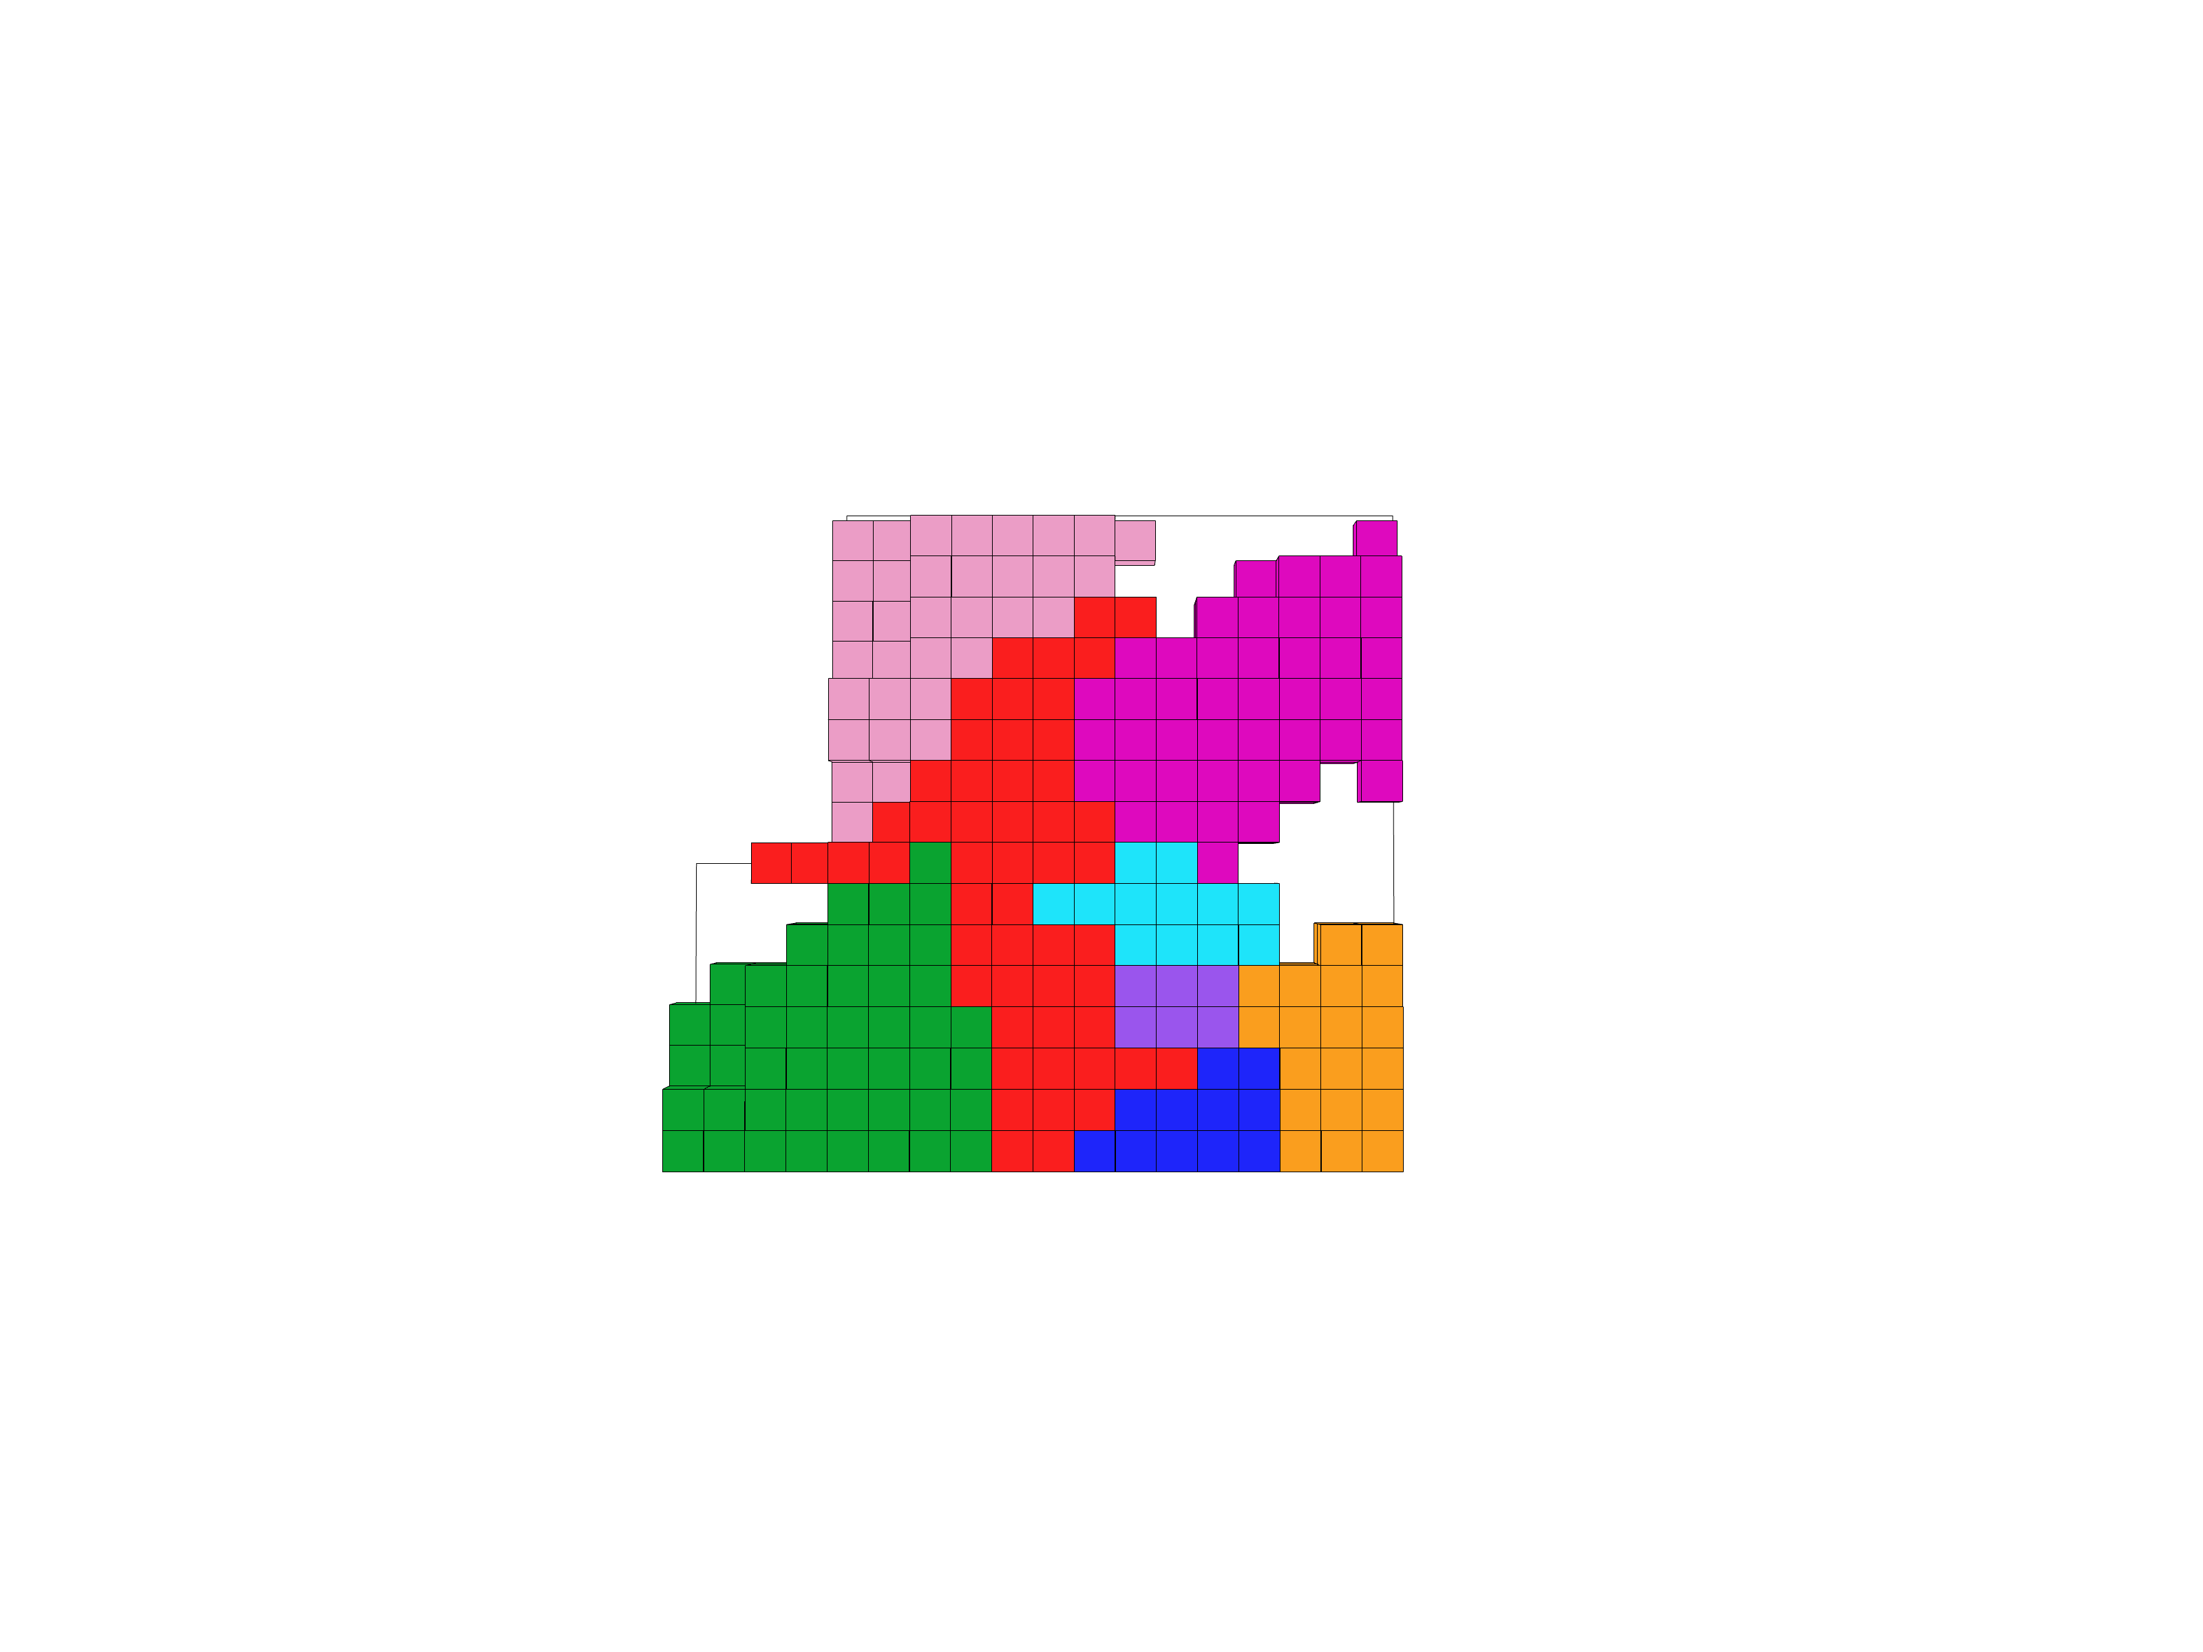
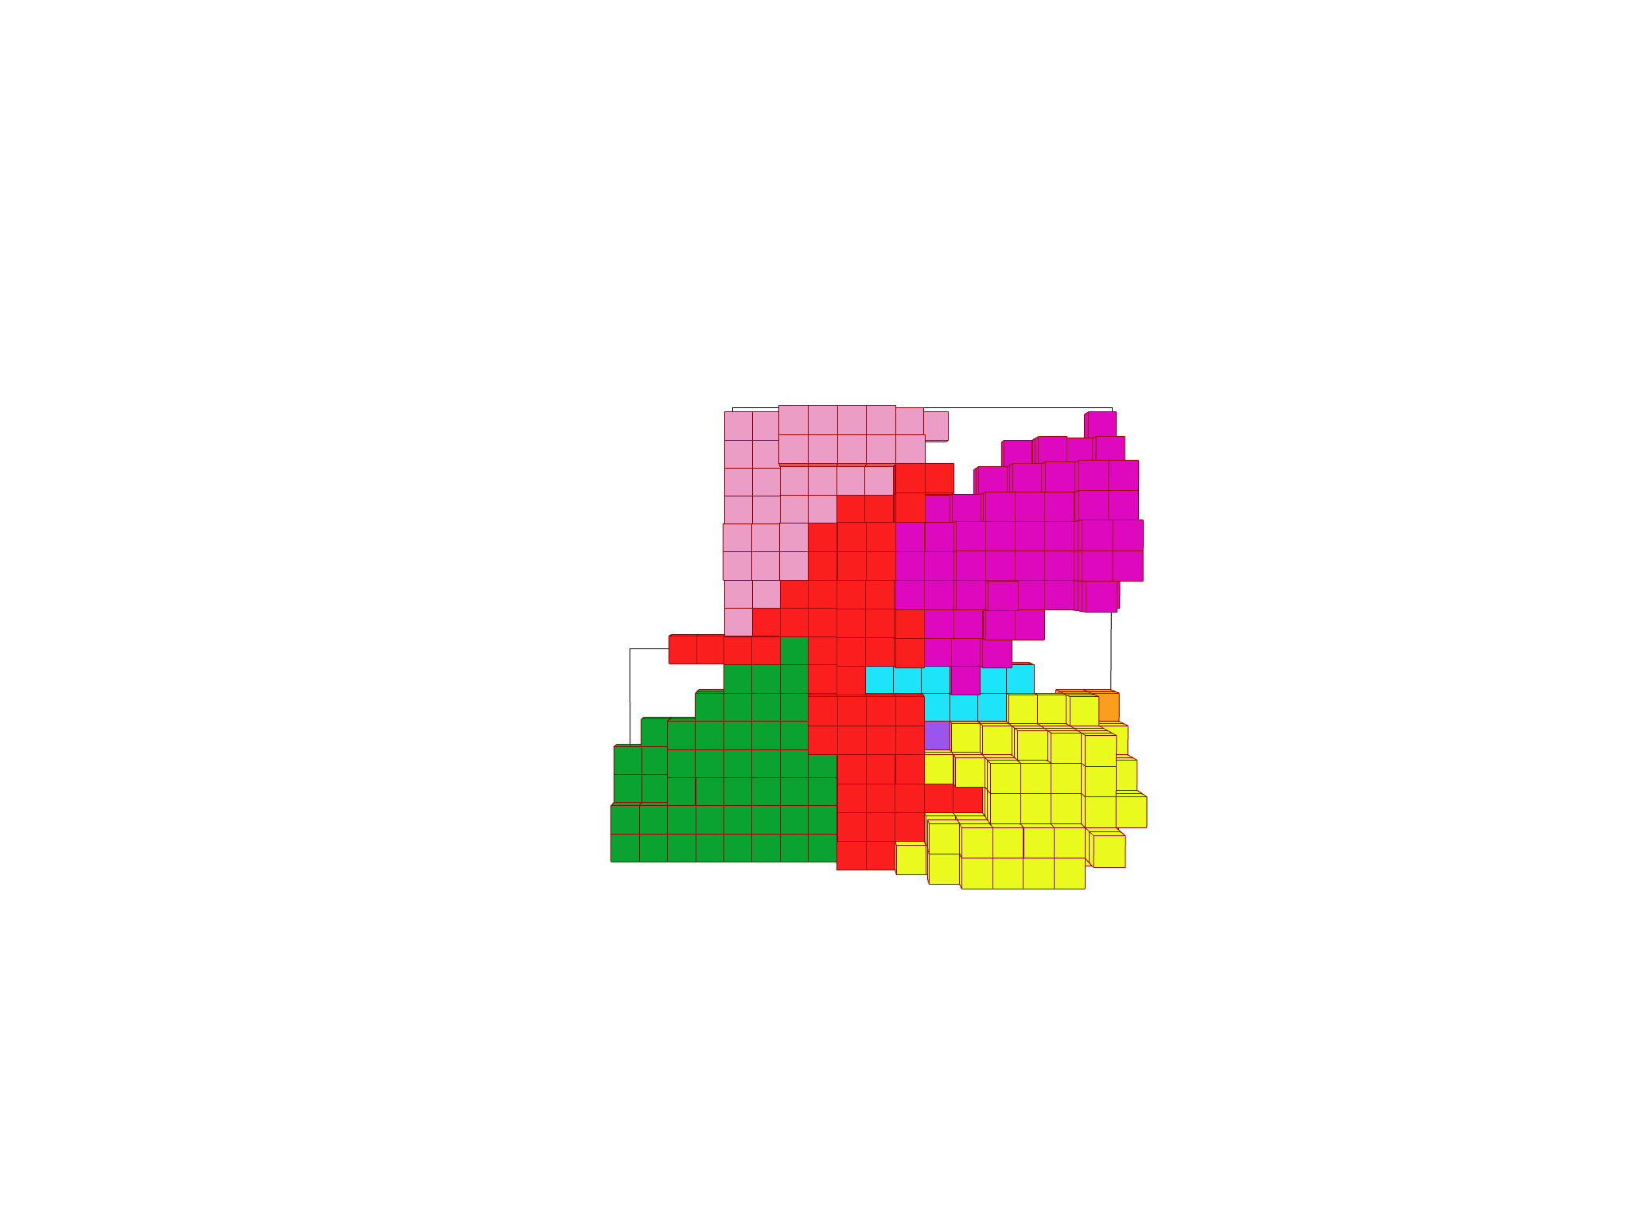
Growing Algorithm: final result
1rst floor
whole building

Slide 41
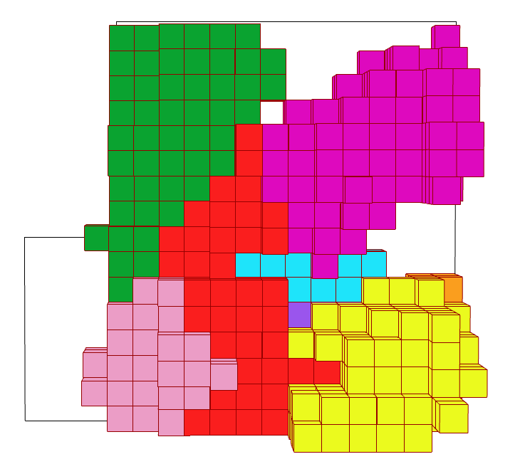
Growing Algorithm: flexibility
Changing the starting points
our design
variant 1

Slide 42
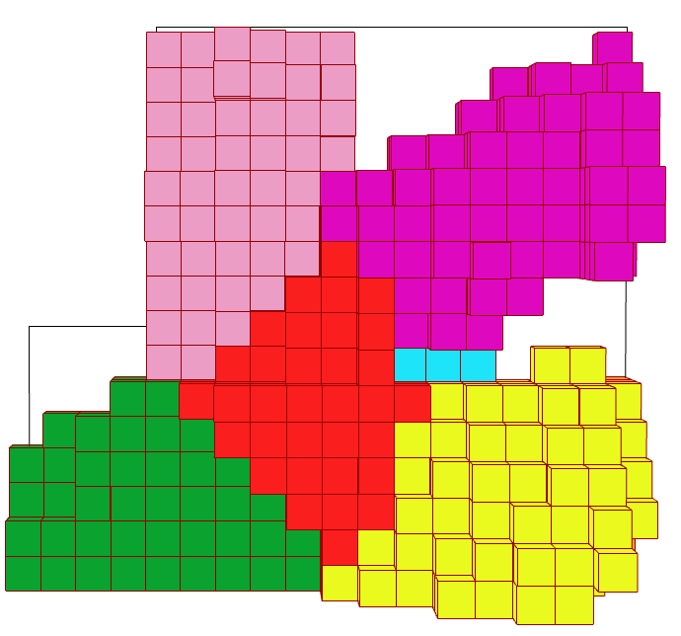
Growing Algorithm: flexibility
Changing the growing direction
our design
variant 2

Slide 43
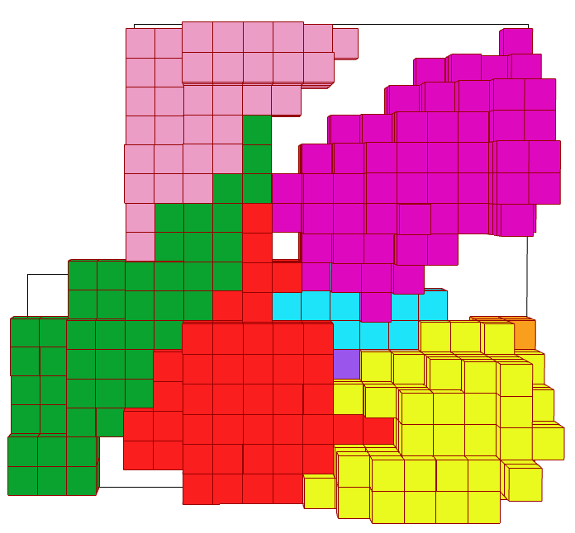
Growing Algorithm: flexibility
Changing the minimum noisevalue
our design
variant 3

Slide 44
Final surfaces of the functions
Function | Surface (m^2) | Space for…
Atrium | 500
Student housing | 894 2384 | 16 student houses = 112 students
Assisted living | 1060 1232 | 23 appartments
Starter housing | 3180 3296 | 62 appartments
Start-up offices + Study places + Library + Coffee corner | 540 600
Restaurant + Pub | 120 152
Cinema | 60 90 | ~50 visitors
Gym | 80 144
Supermarket | 300

Slide 45
Path finding algorithm

Slide 46
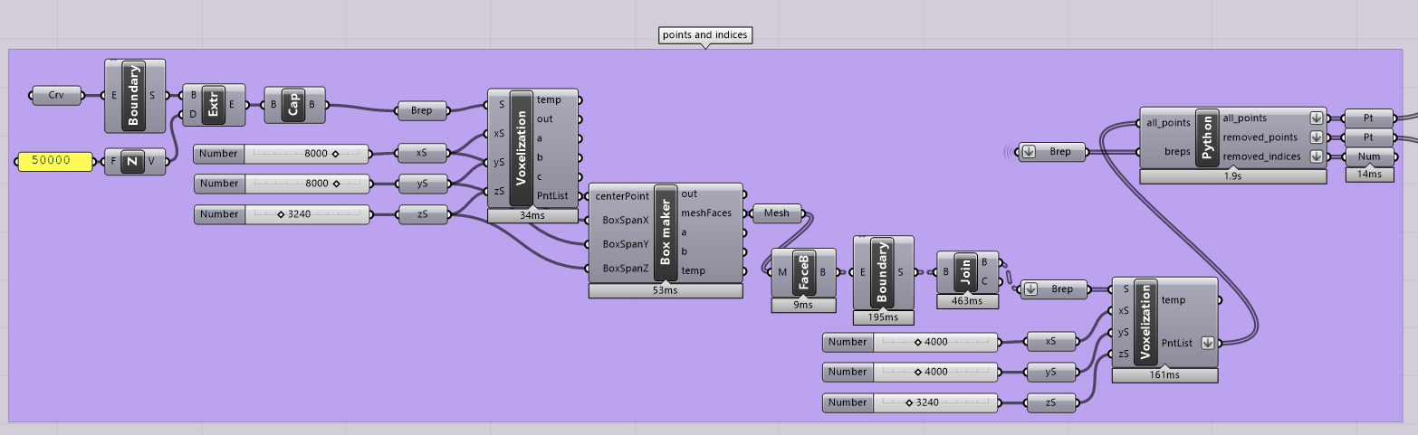
Pathfinding algorithm: find removed points
Input:
All points (point3d, list)
Remaining meshes converted to breps (brep, list)

Slide 47
Pathfinding algorithm: find removed points
Algorithm:
For every point in All points:
Set a counter to 0
Take point [i]
For every brep:
Check if the point is inside the brep.
If the point is in the brep:
append the point to the remaining point list
append the index to the remaining index list
add 1 to the counter
if the counter is still at 0:
append the point to the removed point list
append the index to the removed index list
Append the index to a list for all indices

Slide 48
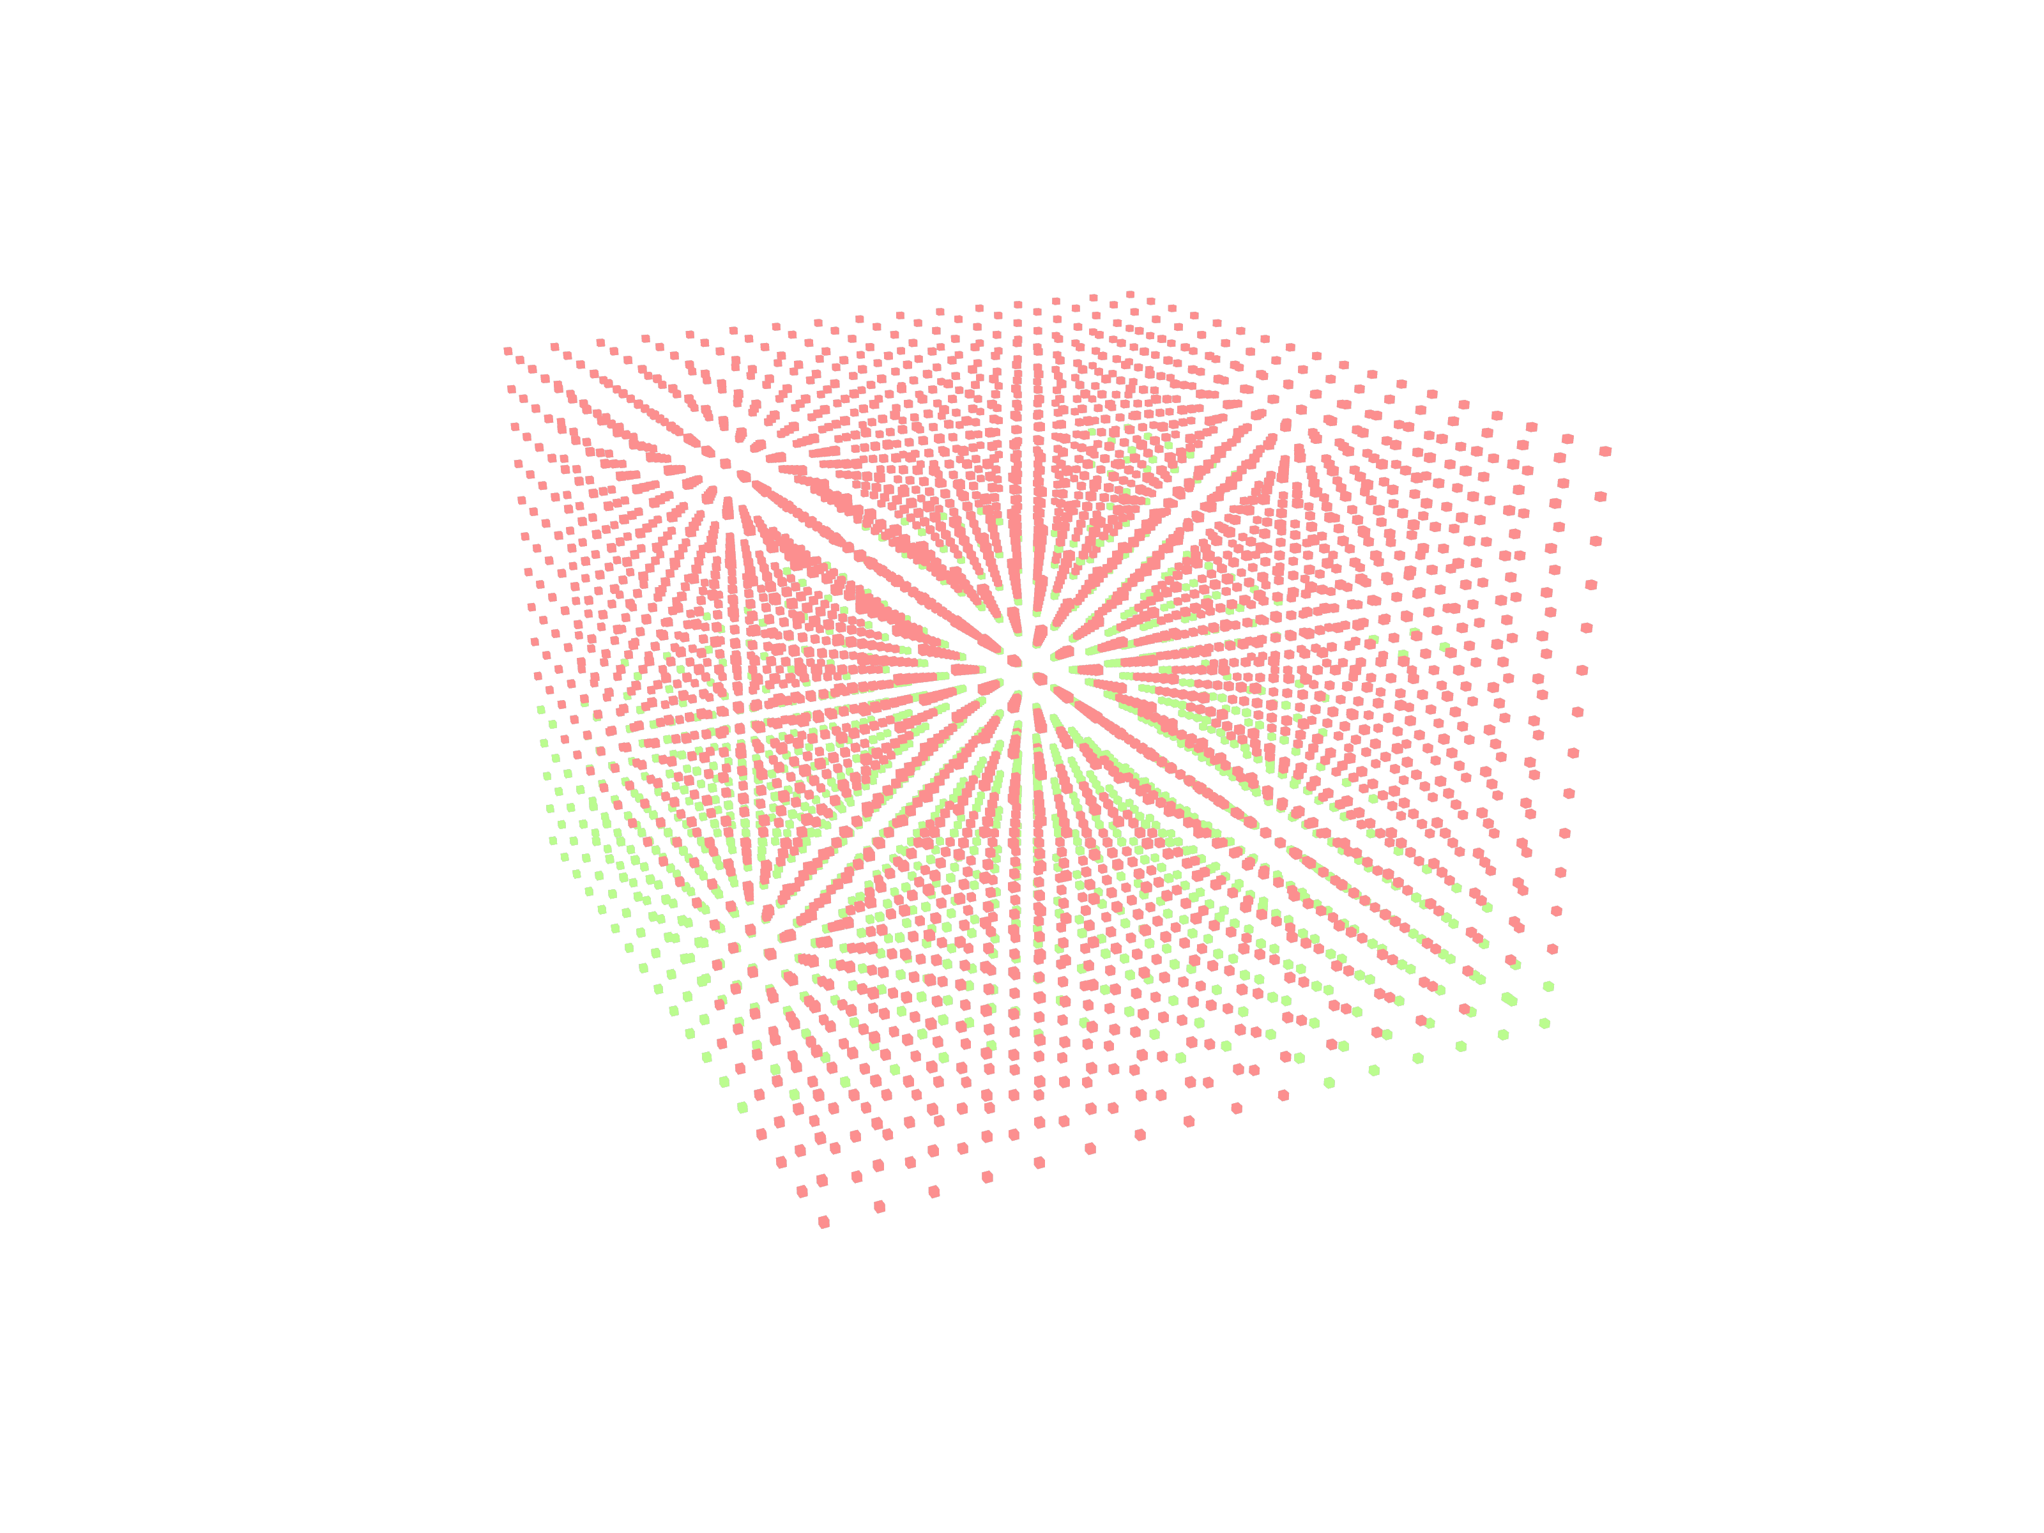
Pathfinding algorithm: find removed points
Output:
All points (point3d, list)
All indices (int, list)
Removed points (point3d, list)
Removed indices (int, list)
Remaining points (point3d, list)
Remaining indices (int, list)

Slide 49
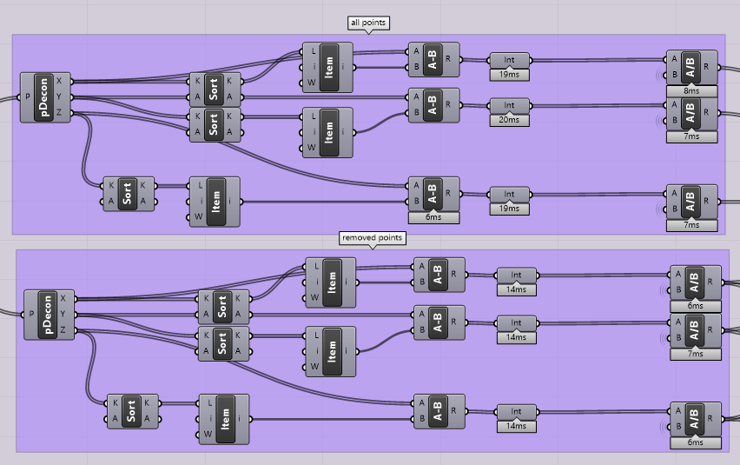
Pathfinding algorithm: deconstructing the points

Slide 50
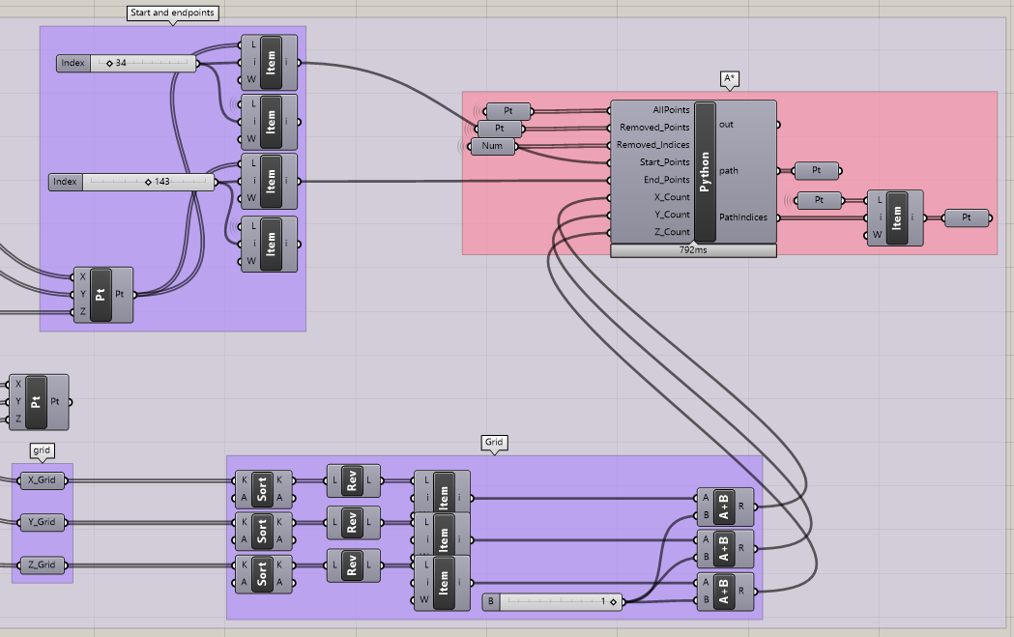
Pathfinding algorithm: creating the input

Slide 51

Pathfinding algorithm: pseudocode
A* finds the shortest path from a starting coordinate to a goal, using heuristics. To use the algorithm, first a graph is constructed from the existing coordinates, with identical index values. Coordinates that are impassable are added to a list of inaccessible points. After the algorithm has found the shortest path, the corresponding indices are returned and the path is constructed in the actual model.
Input:
Grid on the origin in an integer coordinate system (point3d , list)
Inaccessible points (point3d, list)
Indices of the inaccessible points (int, list)
Start points (point3d, item), self defined per floor
End points (point3d, item)
Number of nodes in x, y, z directions (int, item)

Slide 52
Pathfinding algorithm: pseudocode
Algorithm:
Definition: Heuristic(a,b) #only search in XY direction since the corridors all lead to commonly shared climbing points (the end points)
(x1, y1, z1) = a
(x2, y2, z2) = b
return square root ((x1 - x2)2 + (y1 - y2)2)
Definition: A*(graph,start,goal)
Use priorityqueue to check the cost (heuristic) of the current point’s neighbours to the goal, until the goal is reached:
New cost = cost so far
If next point has a lower cost, take this as the new point and search this point’s neighbours
Came from[next] = current
Return came from

Slide 53
Pathfinding algorithm: pseudocode
Class: priorityqueue #definitions to manipulate the queue of points to search next
Definitions: empty #return length, put #heappush, get #heappop
Definition: tuple to point3d
Definition: point3d to tuple
Definition: reconstruct path(came from,start,goal) #Return the path with the lowest total value, and reverse the list since it calculates the path backwards
Definition: find indices(path,points)
for length of the path:
create spheres on the path points
for j in length of all points:
check if the point is inside any sphere, return the indices of the points inside spheres # this could be optimized, as the time increases exponentially with increased points/path list length

Slide 54

Pathfinding algorithm: pseudocode
Class: squaregrid(number of nodes in XYZ direction, removed points)
Definition: in bounds #check if point is in bounds
Definition: passable #check if point is (not) in removed points
Definition: neighbours #find neighbours of the point, only in XY direction
Append((x+1,y,z),(x-1,y,z),(x,y+1,z),(x,y-1,z))
Filter in bounds
Filter passable
Return results
From wikipedia.org

Slide 55
Pathfinding algorithm: pseudocode
Implementation:
#calling the search and initializing the needed lists
#remove the points from the graph that have been shot away by the solar envelope
for every removed point in the actual model:
Create points on the graph that have been removed
Append these points to a new list called Removed Points
graph = Square Grid(W,D,H,RemovedPoints) #creating the graph
start = Point to XYZ(start point)
goal = Point to XYZ(end point)
#calling the search and reconstructing the path
came from = a_star_search(graph, start, goal)
reconstructed path = reconstruct_path(came from, start, goal)
for every point in the reconstructed path:
append the point3d in path points
#outputting the indices form the real pointcloud
Path Indices = find indices(Path Points,all points)
path = Path Points #outputting the path (on the graph)

Slide 56


Pathfinding algorithm: pseudocode
Output:
#corridors are created that find the fastest route from the center of the function to the closest climbing points
Shortest path (point3d, list) per main function
Indices (int, list)

Slide 57




Design
First: generating the floors
Input: lists containing the voxels of each function
Get the centerpoints
Group the voxels into floors (equal z-coördinate)
Take the bottom face of each voxel (normal = (0,0,-1))
Join these faces and take the outside edges
Draw a curve through the controlpoints

Slide 58


Design: Facade
Accentuating the different purposes of the building, and the smart network in between them
By using different materials and styles for de facade

Slide 59



Design: Facade
Student housing: colourful facade

Slide 60


Design: Facade
Assisted living: greenery and balconies

Slide 61


Design: Facade
Starters housing: balconies with enough privacy and a more standard facade

Slide 62



Design: Facade
Atrium: big, open and approachable entrance

Slide 63
Reflection of the process
Most important: learned how to design using algorithms
Challenges:
Optimization
A more defined & integrated pathfinding algorithm
Develop the interior (a more realistic floor plan)

Slide 64

Thank you for your attention

